Slide 1


Advocacy in care
Your voice, your say!
Learning and development
for foster and kinship carers
Notes:
Speaker notes appear throughout this presentation, but these should only be considered a guide. Use your expertise and knowledge to adapt the content as is appropriate to each group of carers and context. It is expected that participants would have some prior knowledge of trauma-informed care.

Slide 2

Acknowledgement
In the spirit of reconciliation, we acknowledge the Traditional Owners of the land on which we meet today and their connections to their land, seas and waters. We pay our respect to their Elders past, present and emerging and extend that respect to all Aboriginal and Torres Strait Islander peoples here today
Notes:
2. Acknowledgement [1 min]
Read slide or provide an acknowledgement specifically recognising the traditional owners of the country on which you are presenting.

Slide 3






Housekeeping
Emergency protocol/exits
Toilets
Breaks
Mobile phone use
Group norms
Notes:
Welcome carers to today’s learning and development module
Outline emergency exits and evacuation plan and location of toilets and other facilities
Notify carers about break times and catering provided
Discuss group norms

Slide 4
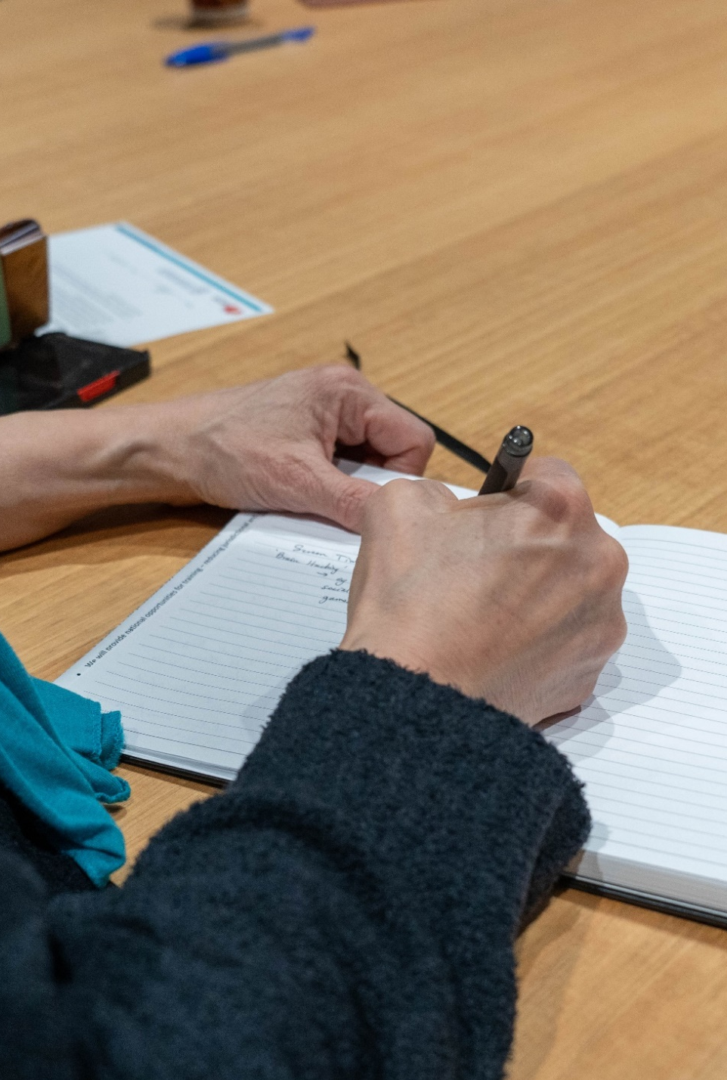

Purpose and learning outcomes
By the end of today’s session, we would like for you to:
Feel empowered to advocate on behalf of your needs as a kinship carer and on behalf of your children and young people
Understand your rights as a kinship carer and your role in decision making
Have the information you need to raise concerns through appropriate pathways to have your voice heard
Know the peak bodies and organisations dedicated to provide advocacy support and those that represent the voices of children and young people in out of home care and their carers
Notes:
Section 82 of the Children and Young People (Safety) Act 2017 entitles carers to participate in any decision-making process relating to the health, safety, welfare or wellbeing of the child or young person in their care.
This module will help you know that you can expect to be informed, supported, valued, and respected as an integral member of the child/young person’s care team. The content will also include additional advice and where to go for support when you may face challenges in advocating for the needs of the child or young person in your care
Read slide

Slide 5

Care team meetings
Care team meeting discussion topics include, but are not limited to:
Reviewing the progress of your child or young person’s development whilst in your care
Sharing information about your child or young person’s needs and wishes as they grow
Collecting information to inform your child or young person’s case plan
Planning for future needs to assist and support your child or young person, particularly if their needs have recently changed
Discussing conflicts within the care team environment or differences of opinion
Sharing joys, challenges and successes
Notes:
Read slide
Here are some tips to prepare for a carer team meeting:
Prior to the care team meeting, it is encouraged that you develop a list of items for discussion, in order of preference or need, especially if there is a worry or concern that needs to be raised
Confirm who will be attending the care team meeting
Request for your support worker or another support person to be present with you if you wish
Decide on a location that is suitable, your home, the DCP office or another community location (or via MS Teams or phone link up)
Ask for meeting minutes to be taken and distributed afterwards so that all decision-making is recorded and clear.

Slide 6

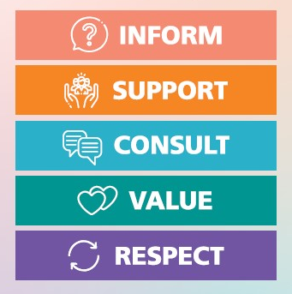
Notes:
The South Australian Statement of Commitment to foster and kinship carers was jointly made by the Department for Child Protection (DCP), Connecting Foster and Kinship Carers SA, and Child and Family Focus SA. It recognises that the department must work in partnership and value carers as an essential and respected part of the care team for children and young people. This document highlights the core commitments the department has made to carers, including that we will inform, support, consult, value and respect all carers. The Statement of Commitment also outlines the roles and responsibilities of everyone involved in family-based care.
Play video [1.28 mins]
To access the video, click on the logo embedded in the slide or visit https://youtu.be/MN4eXcoJlPA

Slide 7

Notes:
Carers are a vital part of a child or young person’s care team and will make many of the day-to-day decisions required to support a child or young person’s needs. Some more complicated or high-risk decisions for a child or young person will need to be made by DCP. The Who can say OK? booklet is a tool to assist everyone who is involved in the care of a child or young person to be clear about who does what when making decisions.
The different types of decisions included in the Who can say Ok? brochure are arranged into general topics of decision making, such as education, health disability, identity and connection etc.

Slide 8


Notes:
This video will introduce you to Connecting Foster & Kinship Carers SA. They are an independent, peak representative body for foster and kinship carers across South Australia and a key partner in the development of the Statement of Commitment.
Play video [2 mins] click on the logo or visit https://youtu.be/YRudTK6_eSg

Slide 9



Making a complaint with DCP
Centralised complaint resolution
Local complaints resolution
If you are not satisfied with the resolution provided at the local level, discuss your concerns with the Central Complaints and Feedback Management Unit (CFMU).
Carers have the right to make a complaint. We are here to support you throughout the process and will take your concerns seriously.
Support Worker
DCP case worker
DCP office supervisor or manager
External complaint resolution
Talk to your support worker either at your next home visit or via phone or email
If you are not satisfied with the outcome by the CFMU, you can escalate your complaint to the external statutory authority, the Ombudsman SA, for independent and impartial review.
Talk to your DCP case worker and/or request a care team meeting
If your worry is still not adequately addressed, you can request to speak with the DCP office supervisor or manager
Notes:
It is common to experience differences in opinion within a large care team, especially because child protection and DCP policies and procedures can be very complex. Carers are not always aware of the decision-making that occurs, and communication can be a barrier to this being shared effectively.
If you are unhappy with a DCP decision or experience, you have the right to raise your concern. Communication is key. Most of the time, a worry or concern can be resolved at the local level. Here are the recommended steps to take to ensure that your voice is heard, and your worry is addressed.
Some other tips are:
Be clear and honest about what your worry or concern is
Have an idea of how you think the care team can work together to solve the problem or worry
Seek support and clarity with help from your support worker who may be able to seek further information on your behalf.
The Ombudsman SA deals with complaints about administrative acts, misconduct and maladministration. For example, your complaint might be about:
a decision-making process
a failure to act or delay in taking action
an unreasonable or unfair decision or requirement
the conduct of staff or delivery of a service
the irregular and unauthorised use of public money or substantial mismanagement of public resources.
The Ombudsman SA assesses all complaints against their own criteria for investigation, to decide whether investigation is necessary or justifiable.

Slide 10
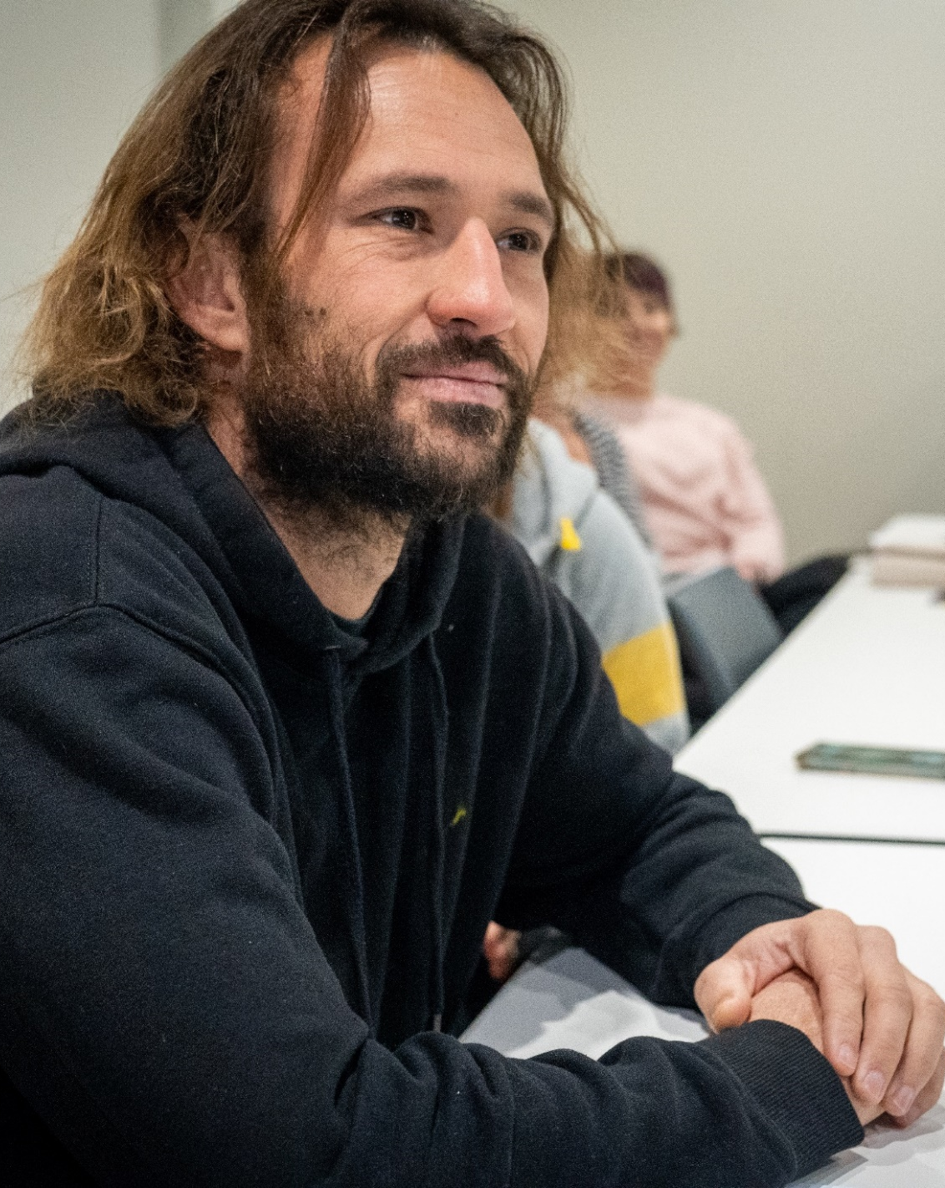
Carers Voice
Value carers’ voices and contributions
Recognise carers' insights and knowledge of the unique strengths and needs of the children and young people in their care
Ensure cultural safety and inclusivity
Respect carers’ time
Genuinely consider carers’ feedback and how it can be incorporated
Inform carers of consultation outcomes
www.childprotection.sa.gov.au/support-and-guidance/foster-and-kinship-care/carers-voice
Notes:
The department encourages carers to have a say in the way DCP does things wherever possible. We know that your perspectives are extremely important for helping us to improve our work.
Carers Voice is a page on the carer section of the DCP website which lists opportunities for carers to provide feedback to the department when we are reviewing policies, processes and services that directly affect carers. When the department reaches out to carers, it is to understand your thoughts and experiences on specific topics. The feedback you provide is analysed by DCP and opportunities for it to inform changes are considered.
Carers Voice is where you will find current carer surveys, past consultation reports and information about upcoming online and in-person consultations. It was developed based on many conversations with carers where we were told that carers would like to see a specific page on our website for opportunities to have a say.

Slide 11


The Office of the Guardian for Children and Young People
Advocating and promoting children and young people’s rights and best interests
Monitoring children and young people’s circumstances to see if their wellbeing needs, rights and interests are being met in care
Advising the Minister for Child Protection on the quality of care provided to them
Making inquiries and advising the Minister about improvements that are needed to systems which affect their care
Investigating and reporting to the Minister on important matters relating to the wellbeing of children in care
Notes:
The Office of the Guardian for Children and Young People (GCYP) advocates for the rights and best interests of children and young people in care and youth detention in South Australia. They provide advocacy on individual and systemic issues, as well as monitoring the safety and wellbeing of children and young people.
Read slide
Anyone who is formally involved with children in care, such as a case worker or carer, must ‘seek to implement to the fullest extent possible, the terms of the Charter’, as outlined in the Children and Young People (Safety) Act 2017. We have a copy of the charter of rights for you today.
The most appropriate way to inform the child or young person of their rights will depend on their developmental capacity and age. That said, even young children can understand their rights and must be provided with developmentally appropriate information.

Slide 12

Wakwakurna Kanyini – for South Australian Aboriginal children and families
Amplify the voices of children and young people
Partner with government to reduce the overrepresentation of Aboriginal children in the child protection system
Build capacity of Aboriginal Community Controlled Organisations
Notes:
Wakwakurna Kanyini means ‘Holding on to our children”. Wakwakurna Kanyini was established in 2024 and is the new peak body responsible for amplifying the voices of Aboriginal children and young people, partnering with government to reduce the over representation of Aboriginal children in the child protection system, and building the capacity of the community-controlled sector to provide services to Aboriginal children.
Wakwakurna Kanyini will be a strong and independent community voice that will provide leadership on the representation of community-led priorities to the state government. It will focus on improving outcomes for Aboriginal children and families and on building the capacity of the Aboriginal Community Controlled sector to provide services to families in need.
Having a peak body responsible for amplifying the voices of Aboriginal children and young people is a significant milestone that will help ensure that Aboriginal children and young people have the best opportunities to safely live their live with family and community.

Slide 13

Supporting children’s participation
Through direct participation in formal meetings with the care team
During case plan meetings and annual reviews
Sharing their views informally with their carer or DCP case worker during home visits
Completing surveys
Drawing, story-telling, a written narrative or representing their wishes in way that is meaningful to them
Notes:
Not only do children have the capacity and willingness to participate, but they also have the right to participate.
Children and young people are active citizens in their own right, entitled to have a say in the decisions that affect their lives. Aboriginal and Torres Strait Islander infants, children and young people have the right to know about, and connect with, their cultural heritage and identity. Consistent with this, the Children and Young People (Safety) Act 2017 (CYPS Act) requires that if a child or young person is able to form their own views concerning their care, they should be given the opportunity to express those views freely and have due weight given to them in accordance with their developmental capacity and circumstances. Consulting children about their experiences and involving them in decision making can contribute to better outcomes for children and young people, with increased self-esteem, confidence, and social skills.
Children and young people’s individual circumstances or needs (including aspects such as their chronological, developmental or emotional age, disability, current emotional functioning and their willingness to engage) may affect their understanding and engagement.

Slide 14

Build communication and relationship between children, young people and DCP case worker
Support children and young people to give their perspective without input by others
Provide DCP case workers insight into children and young people’s experiences, worries, hopes and dreams
Provide DCP case workers insight into Aboriginal children and young people’s experiences, awareness, confidence and pride in their identity and a sense of belonging to their family, community, Country and culture
Identify issues which case workers must follow-up, discuss and explore with children and young people
Notes:
My Voice Our Views - a bespoke survey tool. My Voice Our Views, has been developed for children and young people in care to capture their views about their time in care. Every child or young person aged 5 to 17 years, who has been in care for three months or more must be invited to complete a child survey on My Voice Our Views at least once every 12 months.
My Voice Our Views is a survey tool is designed to:
Here is a short video that has been prepared by DCP for children to introduce them to the survey. This will give you an idea of what children and young people are invited to share.
To access the video, click on the logo embedded in the slide or visit https://youtu.be/o25PZzI8q2s?si=3Tfdwc7CRfx5fQ57

Slide 15






Notes:
The CREATE Foundation is contracted by the department to provide advocacy and support services on a state-wide basis to children and young people currently in or entering care, and inclusive of those that have exited care to the age of 25 years. CREATE’s advocacy work extends beyond their Youth Advisory Groups, they also submit papers to government about their advocacy priorities on behalf of children and young people, such as sibling connection, Residential Care, Health and Wellbeing and Transition from Care.
This next video introduces us to some of the programs, tools and resources created by children and young people for children and young people.
To access the video, click on the logo embedded in the slide or visit https://youtu.be/v2DkS_cfMt0

Slide 16
Document control
Reference No./ File No.
Document Owner |  | Lead Writer (name, position)
Directorate/Unit: Strategy, Partnerships and Reform |  | Senior Project Officer, Strategic Projects, Strategy, Partnerships and Reform
Accountable Director: Executive Director Strategy, Partnerships and Reform
Commencement date | February 2025 | Review date | February 2028
Risk rating Risk Assessment Matrix | Consequence Rating | Likelihood | Risk Rating
 | Minor | Unlikely | Low
REVISION RECORD
Approval Date | Version | Revision description
31 January 2025 | 1.0 | Approved
___________________________________________________________________________________________________________________________________________
Advocacy in Care – Your voice, your say! Slide 22/22
V1.0 February 2025

