Slide 1


The Impact of Alcohol
& Other Drugs on
Families and Children
Learning and development
for foster and kinship carers

Slide 2

Acknowledgement
In the spirit of reconciliation, we acknowledge the Traditional Owners of the land on which we meet today and their connections to their land, seas and waters. We pay our respect to their Elders past, present and emerging and extend that respect to all Aboriginal and Torres Strait Islander peoples here today
Notes:
Read slide or provide an acknowledgement specifically recognising the traditional owners of the country on which you are presenting.

Slide 3






Housekeeping
Emergency protocol/exits
Toilets
Breaks
Mobile phone use
Group norms
Notes:
During our session today, you might find yourself thinking about your family, how you were raised, or how you’ve raised your own children or kin or your own use of alcohol and/or other drugs. It’s natural for this type of learning to be emotional sometimes so if you find yourself feeling overwhelmed, please feel free to stop and take a break.
It’s important to note that the information provided here is an overview only. The child protection system and the impact of alcohol and other drugs on families and children is an incredibly complex topic, and we acknowledge that even thinking about all the content can make you feel overwhelmed. You are not expected to know all of this or remember it all If you want to revisit this information at any point, we encourage you to speak with your support worker or DCP case worker.

Slide 4

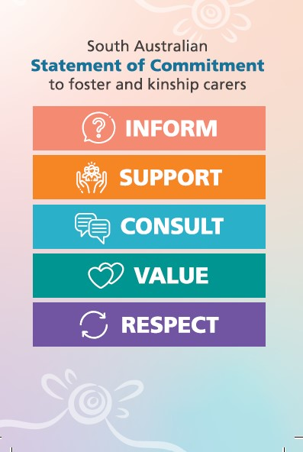
Notes:
The South Australian Statement of Commitment to foster and kinship carers was jointly made by the Department for Child Protection (DCP), Connecting Foster and Kinship Carers SA, and Child and Family Focus SA. It recognises that we must work in partnership and value carers as an essential and respected part of the care team for children and young people. This document highlights the core commitments the department has made to carers, including that we will inform, support, consult, value and respect all carers. The Statement of Commitment also outlines the roles and responsibilities of everyone involved in family-based care.
The purpose of the Statement of Commitment is to act as a supporting document for carers when working alongside child protection staff, and it also informs best practice for staff.

Slide 5


Purpose and learning outcomes
By the end of today’s session, we would like for you to:
Gain further information about how substance use during
pregnancy and throughout the early years can impact child
development now and into the future
Take away ideas and strategies to care for children and
young people that may have been impacted by parental
substance use pre and/or post birth
Feel less alone in your caregiving role
Notes:
Alcohol and other drug use is a common child protection concern that can result in children coming into care at any age. The fact that we are all here today, says that we are all impacted by this in some way.

Slide 6
An overview – The National Drug Household Survey 2022-23
Around 1 in 3 people (31%) in Australia drank alcohol in ways that put their health at risk in 2022-23
1 in 5 people in Australia has used an illicit drug in the last 12 months, equalling about 3.9 million people. This is an increase from 3.4 million from 2019
Since the last survey in 2019, risky alcohol consumption in the community has not increased or decreased – it has remained stable
Young women (18 – 24 years) have been found to be more likely to have used alcohol and other drugs than in 2019
Around 1 in 4 women drank alcohol at some point during pregnancy, this statistic has steadily declined since 2013
Notes:
Alcohol and other drug use is common among families involved with the child protection system. Children and young people who are in care may also use alcohol and other drugs. We are here to help you understand how children, young people and their families can be impacted.
We would also like to reduce the shame and stigma related to substance use, and to do this, we will introduce you to the prevalence of substance use in our community with some interesting facts about who in the community are most vulnerable. There are known links between childhood trauma and future alcohol and other drug use.
“Stigma creates a cycle of self-stigma, shame, and unworthiness” (Alcohol and Other Drug Foundation).
Alcohol by far is the most commonly used drug of dependence, and it’s legal and socially acceptable. There is significant harm related to alcohol use that contributes to poor health but also harm to the community in terms of anti-social behaviour, violence, accidents and police resources. The most commonly used illegal drugs are cannabis and methamphetamines.
Ref: Information from National drug household survey 2022/2023 Australian Institute of Health and Welfare

Slide 7
Story circle
Notes:
Activity – the purpose of this activity is to provide a safe space for carers to share the impact of alcohol and other drugs on their own family network. A story circle allows participants to take turns sharing personal experiences and narratives, with a focus on building connection and understanding among the group and promote wellbeing.
Now having a bit of information about the prevalence of substance use in our community, we would like to open discussion within the group to share our experience about how substance use has impacted our lives. This is completely optional. We aim to create a safe and respectful environment, so we ask that during this yarn, we provide each other with comfort and validation.
Together, in our shared experiences, we can help to reduce the stigma around substance use and break down the barriers that exist that prevent people from seeking out help and support for their use. This may include your children and young people at a point in their lives.
Assist the group to hear the following main messages:
Stereotypes and common assumption in the community – we need to start challenging these if we are going to create opportunities for people to seek help
Separating the behaviour from the person (use is a person’s behaviour, not a feature of the person) will help carers view their loved ones differently
Not avoiding hard conversations – the best way to help another person is by showing up and having the difficult conversation
Stigma prevents people from asking for help – we need to mindful of our language, not ‘drug user’ or ‘junkie’ but ‘a person who is impacted by substance use’ or a ‘person who using drugs’
Empathy and a willingness to understand helps with relationships between yourselves and birth parents and yourselves and your children and young people.

Slide 8

The impact on families
Financial difficulties
Challenges with housing and employment
Family dysfunction
Legal issues
Mental health
Social isolation
Increased risk of domestic and family violence
Notes:
Many families who experience problems with alcohol and other drugs can have other complex issues such as mental health difficulties, physical health conditions, domestic and family violence and trauma, to name a few. It’s important for us all to understand the connection between substance use and other contributing factors to life stress.
The pressure of multiple life stressors can greatly decrease a person’s resilience and without appropriate coping skills, they may be more vulnerable to using substances as a way to manage/cope.
Other than compromising personal health, parental substance use has profound impacts on family functioning such as family conflict and relationship breakdown, and the ability to provide care to children and young people.
The prevention of misuse is a community responsibility. The department relies on multiple public health systems to educate and support our children, young people, families and communities and DCP becomes involved only when the attempts from these other services have been unsuccessful in keeping a child safe.
We recognise the overrepresentation of Aboriginal and Torres Strait Islander children and young people in care as a result of intergenerational trauma and the ongoing impact on families. We hope at the end of today’s session you feel informed and empowered to support the children and young people in your care and know how and where to seek further support when you need it. We know this experience of trauma can affect family’s use of drugs and alcohol, including children and young people in care.

Slide 9
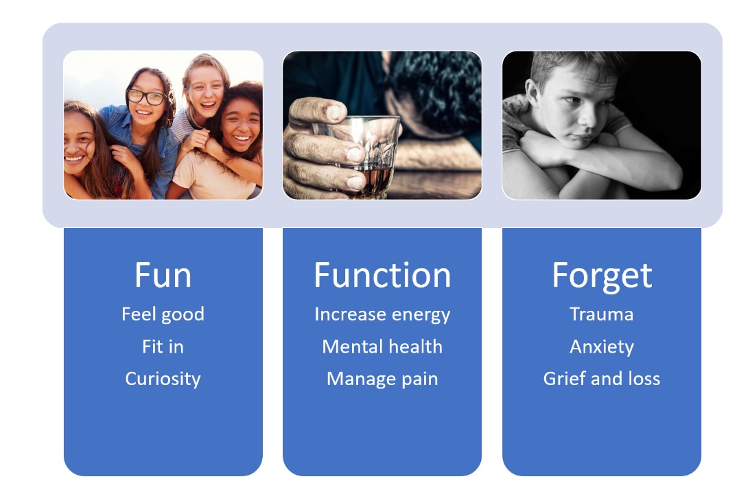
Notes:
Why do people do drugs? People use for three main reasons: The three Fs – fun, function or to forget.
Fun – for those who use substances for fun/recreation, they experience a euphoric high. If people did not initially enjoy the feelings that they experience from drug use, then it would be unlikely that they would do it again. All drugs affect our dopamine reward system, dopamine is our “feel good” or pleasure hormone. How does dopamine work? Drugs activate our positive re-enforcement pathway. People don’t tend to experience negative consequences until much later.
Function – for example, some people use substances to increase their function or energy levels. You may have heard some people using substances to increase their attention or energy levels for specific purposes. Some people use substances to manage chronic health or pain conditions or manage the symptoms associated with poor mental health.
Forget – relevant to people who have experienced trauma and particularly for Aboriginal and Torres Strait Islander people, where intergenerational trauma continues to impact the health and wellbeing of those who remain disconnected from community, country and culture.
Drug use may be due to one or all these reasons combined. Not all people that engage in alcohol or other drug use become tolerant or dependent or addicted. For some people, their use doesn’t become problematic. Some people’s use could be considered experimental (once or twice out of curiosity) often the case in adolescence. Recreational use (enjoyment to enhance mood for social occasions), or situational (to cope with the demand of a certain situation).

Slide 10
The cycle of use
Use
Use
Tolerance
Use
Withdrawal
Addiction
Dependence
Use
Notes:
The cycle of use is where we are able to identify where a person may be on their journey. As you can see, for someone who may be using substances to forget, they can become dependent due to the cyclic nature of addiction. For example, if someone is low in mood, experiencing lethargy due to depression or other factors, they may engage in amphetamine use which helps them feel better in the moment. Later, the central nervous system restores to their baseline affect and triggers that person to use again to experience that good feeling once more. The cycle continues. Understanding a person’s use assists DCP case workers to support those in the cycle of substance use and intervene and provide referral and support for drug and alcohol counselling which can assist people to identify their own patterns, triggers and behaviours around their use.

Slide 11

Nuggets - Little kiwi animation
Notes:
11. ‘Nuggets’ - Little Kiwi animation [10 mins]
https://www.youtube.com/watch?v=HUngLgGRJpo – [5.05 mins].
Reflection: does anyone have any reflection that they would like to share following this video?
Participants may require prompting to gain further insight into the cycle of addiction by hearing the thoughts and reflections of others.
Little kiwi showed a genuine curiosity in the beginning of his journey, which could essentially happen to anyone
Little kiwi was not experiencing dependence in the first few times of use, in fact, he was enjoying himself
Little kiwi started to decline in his mood and physical appearance, which were signs of dependence
Little kiwi attempted to make himself feel better from the withdrawal from substance use by using again
Little kiwi experienced a dependence where he needed to use more (quantity) and more frequently.

Slide 12

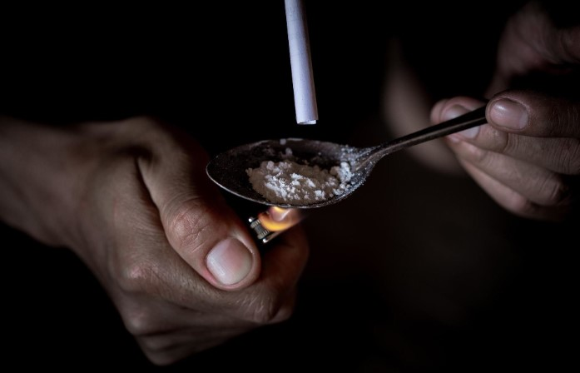
Facts
A drug is any substance that, when consumed, alters the body (physiologically) and/or the mind (psychologically)
Drugs can have different effects (positive and negative) depending on how they act on the brain and nervous system
Most drugs act on our brain’s reward system to produce feelings of pleasure
Some people with trauma may use drugs to reduce their emotional distress or pain and increase their positive feelings
Notes:
Having a better understanding of how substance use impacts the body, and mind will help us understand the journey that birth parents have experienced that may have led to them not being able to be the best version of themselves and provide safety for their kids. Having this knowledge will also help you recognise signs and symptoms of use in our children and young people.
One way to categorise drugs is by their impact on the nervous system. The nervous system is your brain and your spinal cord and the two are attached by your brain stem and connects all of your nerves that lie outside of the nervous system to organs limbs and skin.
Optional information:
The way that drugs are absorbed into the body is dependent on the way that they are taken, for example via injection into the skin/muscle, smoking, or ingesting. Each method has a different delivery system and is processed by different parts of the body. For example, intravenous use (injection or under skin, in muscles) goes straight into blood stream able to circulate around body instantly, crosses blood brain quickly. Smoking enters the body through our lungs or ingestion through stomach and small intestines, processed in the liver and then enters blood stream.
Definition of a psychoactive drug: substances that, when taken in or administered into one's system, affect mental processes, e.g. perception, consciousness, cognition or mood and emotions.

Slide 13

Child Protection
Substance misuse can compromise a caregiver’s ability to ensure the safety and wellbeing of their child in the following ways:
Lack of routine
Missing childcare/kindy/school
Inadequate supervision
Unsafe home environments
Lack of access to food
Inconsistent parenting
Needs not being met
Impact on quality of relationships
Exposure to dangerous or criminal activity
Parentification
Notes:
The Children and Young People (Safety) Act 2017 gives DCP powers to ensure all children and young people are safe from harm. Substance misuse becomes a child protection issue when it causes children and young people harm or places them at risk of harm. As we have discussed, substance misuse can compromise a caregiver’s ability to ensure the safety and wellbeing of their child.
Substance misuse can have a range of negative impacts on parenting and children and young people. A caregiver’s capacity to provide responsive and emotionally attuned care can be compromised either when they are affected by the substance (i.e. “high”) or during withdrawal or recovery (i.e. “coming down”). For example: some people might justify their use by saying that they only use substances at night whilst the children are asleep or only on the weekends that the children are with another caregiver. This does not necessarily reduce risk, particularly in the withdrawal or recovery phase. Effects during the withdrawal and recovery phase could include irritability, aggression, paranoia or impaired judgement, as well as being physically unable to respond appropriately to the child to ensure their safety or meet their needs.
Additionally, caregiver substance misuse can place children and young people at risk of accidental ingestion of or exposure to substances or needle stick, or other drug paraphernalia injuries. Children and young people may also experience emotional harm where they are exposed to the effects of substance misuse on their caregiver such as reduced alertness or unconsciousness. These experiences can be extremely frightening for children and young people.
Children and young people could also be exposed to dangerous or criminal behaviours associated with the purchase or production of illicit substances that could pose risks of emotional and physical harm. Children and young people may also be left alone when their caregivers are out of the home seeking or using substances. In addition, caregivers may prioritise the financing of substance misuse above the needs of their children and thus children and young people may be deprived of necessities such as food.
Infants and young children are particularly vulnerable to harm as a result of caregiver substance misuse. Infants and young children are entirely dependent on their caregivers and where the caregiver’s ability to meet these needs is compromised as a result of substance misuse, the consequences experienced by infants and young children can be significant, including child death.
In addition to the risks posed to children and young people when their caregivers are substance affected, they may be vulnerable to harm perpetrated by others. For example, a parent may be unable to appropriately supervise the child due to their substance misuse which may enable a perpetrator of harm to have greater access to the child.
Children and young people in care can experience a range of adverse outcomes as a result of their trauma experiences and require security and stability to promote emotional wellbeing and healing from trauma.

Slide 14
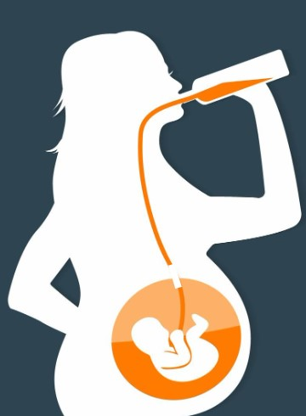
Substance use during pregnancy
Consumption during pregnancy has been shown to alter the placenta, reduce placental weight and increase the risk of the placenta detaching
The placenta is not a barrier to substances entering the foetal circulation and is equal to the mothers’ blood concentration within an hour
All types of substances have the potential to impact the developing baby, and no threshold level or amount has been established as safe during pregnancy
Notes:
Consumption during pregnancy can increase the risk of miscarriage, premature birth, stillbirth, low birthweight, as well as being born small. Some of you will be caring for children who have experienced exposure to substances prior to birth.

Slide 15
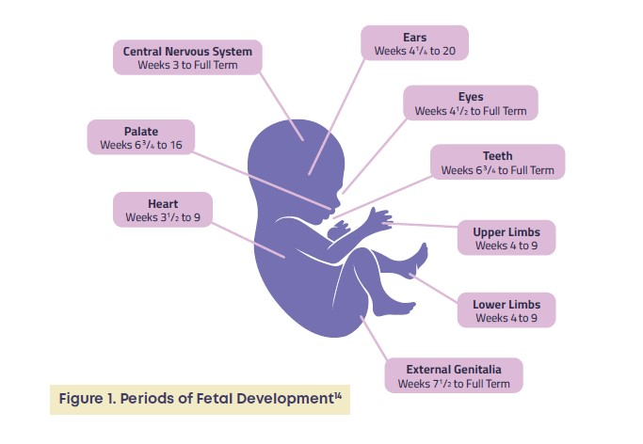
Impact on
children in utero
Notes:
During the early weeks of pregnancy, the developing embryo is particularly vulnerable to the effects of substances. Exposure can alter the development of cells that go on to form the placenta. The developing foetus is most vulnerable to structural damage during the first three to six weeks of gestation.
The foetus has limited capacity to process substances and therefore, alcohol or other drugs enters unchanged into the amniotic fluid. When the foetus swallows the amniotic fluid, this prolongs the duration of exposure.
Timing and dose of exposure both impact the type of organs and systems affected, as well as the extent to which they are affected. For example, if exposure occurs while the heart or kidneys are developing, this may result in congenital defects of these organs. Brain development, which continues throughout pregnancy and into the early years of childhood, may be impacted by exposure at any time during pregnancy.

Slide 16

The effects of FASD on carers and families
Notes:
Prenatal exposure can disrupt the development of all the organs and systems in the body and can result in an array of neurobehavioural and physical outcomes collectively known as Foetal Alcohol Spectrum Disorder (FASD) or NAS (Neonatal Abstinence Syndrome).
FASD specifically, is a condition that requires a diagnosis and maternal substance use during pregnancy needs to be confirmed to reach a diagnosis. If you have concern about your child’s development and suspect that your child or young person may have been exposed during pregnancy, speak with your support worker or DCP case worker and they can guide you towards seeking an assessment.
Even without a diagnosis, children who have been exposed to substances in utero can experience challenges in a range of different domains including executive functioning, language development, learning and memory, adaptive functioning, and academic performance. It is a spectrum and there are a wide range of factors that influence children’s development. Children also experience increased rates of asthma, as well as eye, skin and heart conditions, compared with the general population.
Here is a video of a caregiver speaking to the experience of providing care for a child who has experienced parental alcohol use during pregnancy and has been diagnosed with FASD. This video has been produced by NoFASD, a National organisation for foetal alcohol spectrum disorders.
Video The effects of FASD [5.08].
https://www.nofasd.org.au/parents-caregivers-family/understanding-fasd/the-effects-of-fasd/
The majority of children and adults who have FASD live with significant cognitive, behavioural, health and learning difficulties, including problems with memory, attention, cause and effect reasoning, impulsivity, receptive language and adaptive functioning difficulties. These difficulties are lifelong and have a significant impact on behaviour. Positive outcomes can be achieved when caregivers are appropriately supported to understand their child’s behaviour as a symptom of brain damage.
Ref: fasdhub.org.au and NOFASD’s website: nofasd.org.au.

Slide 17
Story circle
Notes:
We would like to hear from you about your child’s development. Child development and what is considered normal is varied, but if we know that our children have been exposed to substances in utero or experienced an unsafe environment due to parental substance use following birth, we can better understand their behaviour and therefore, learn new ways to respond to them therapeutically. This is completely optional, we learn a lot from each other's experiences and identifying some common challenges in raising children and young people who have experienced a difficult start to life will help us with our next section where we look at common behaviours, and tips and strategies that may be helpful to you.

Slide 18

Impact on children’s development and behaviour
We know that exposure to parental substance use in early childhood will impact on child development, particularly brain development:
Memory
Impulse control
Sensory needs
Sleeping and eating
Information processing
Speech/language
Notes:
Children and young people who have experienced abuse and neglect as a result of parental substance use will most likely have impacts on their attachment and how they form relationships, how they understand themselves and how they respond to the world around them. Recognising the developmental and attachment needs of children is important because it impacts not only on the child or young person’s development but also on their adult functioning.
We need to understand typical child and adolescent developmental trajectories and milestones to be able to identify where children or young people may be experiencing developmental delays and/or disability.

Slide 19


Memory
Some behaviours you may notice in children and young people with challenges with memory are:
Difficulty concentrating
Difficulty with spelling and comprehension
Challenges with following directions or forgetting instructions
Remembering only specific details about what is said
Appearing to regress with previously learnt skills
Appearing distracted or becoming distracted part way through an activity
Restlessness or fidgeting
Overwhelm and outbursts
Notes:
Memory is about retaining and storing information and understanding and using prior knowledge for later use. It is the case that children who have been exposed to substances during pregnancy may get something right one day, even the next, then on the third day it is as if the skill has never been learnt. The lack of consistent knowledge means rules for sport or the spelling of words or remembering number concepts results in not being part of the team or relentless work on daily schoolwork tasks until they have it correct. This can be frustrating for carers too.
Strategies to support children with memory or attention challenges:
Provide only one direction at a time and limit to 6 concrete words
Use a lot of repetition. This is the rule of thumb. Then teach and re-teach in each different environment – at home, at school, at the playground, when visiting family and friends
Break down information into smaller sections and relay one section at a time. If the child looks confused, then it is your job to break the information into even smaller pieces
Provide modelling and mentoring – walk through an activity together
Use visual tools – a calendar, charts, memory boards, scrap books
Use tools like a video recorder or take photos (in sequence for use as a memory prompt) of the child getting ready for school - washing face and/or hands or showering, clothes on the bed and getting dressed, shoes on, lunch in bag, going to car
Use a tape recorder and record the child reading the steps for daily routines (e.g. brushing teeth).

Slide 20


Impulse control
You may notice children and young people with poor impulse control to display some or all of the following behaviours:
Poor decision making
Risk taking behaviours
Apparent lack of consequence and trouble following rules
Emotional regulation
Overreaction to situations
Aggression
Attention seeking behaviour
Challenges with friendships
Notes:
Poor impulse control can place children in risky and dangerous situations. It's about stopping and thinking before taking an action but with a lack of impulse control, often the ‘thinking’ step that comes before the action is missed or lost. You may notice children having emotional outbursts, engage in rule breaking, experience attention difficulties, anger and show an apparent failure to see or understand consequences for their behaviour.
Tips you might consider are:
Anticipate behaviours (watch for warning signs) and try to help the child avoid unwanted consequences
Try to set up the environment to prevent unwanted behaviour occurring in the first place
Try and find the source of frustration and plan realistic routines to avoid ‘acting out’ (for example, don’t take them to the busy shopping centre late in the day when they are over tired)
Use short-term clear and consistent consequences specifically related to the target behaviour
Establish small achievable goals – remember to give praise for what they did do rather than focus the attention on what they didn’t achieve
Provide skills training and use role play
Time in – generally time out is ineffective after about a minute as some may forget why they are there
Offer a quiet space which is different and not associated with discipline to which the child can go to be alone (if appropriate)
Where possible, maintain consistency and predictability throughout the day
Role-model positive behaviour in response to challenges

Slide 21


Sensory needs
Children and young people with sensory needs may express their feelings through their behaviour in the following ways:
Sensory seeking
Irritability
Emotional dysregulation and outbursts
Clumsy or have poor balance
Difficulties paying attention
Fidgeting
Mouthing non-food items
Sensory avoidant
Avoiding bath time
Dislike for loud and crowded environments
Pulling away from physical touch
Particular with clothing, bedding and textures
Notes:
Sensory issues can affect a child’s capacity for maintaining attention when a child is over-stimulated by their inner world, their own mind.
Sensory means – smell, taste, noise, touch, or light. If a child is hypersensitive to one or more of these areas, it can draw attention away from a task and make concentration difficult. Your observations become most important in recognising your child’s sensitivities such as: tags on clothing, particular materials, competing background noise, or bright and busy environments.
Having an understanding of your child’s sensory profile will help you understand and anticipate some of their behaviours that you might be noticing. Some children will have sensory seeking or sensory avoidant behaviours or even a mixture of both.
Some things you could consider to reduce the impact of some sensory triggers might be:
Limit the length of time to expect a child to stay on task or break into smaller parts
Provide a lot of one-to-one physical presence
Take steps to avoid sensory triggers – lighting, noise, clothing textures, colours of walls and furnishings, cluttered rooms.
Desensitise the child to her/his environment. Use trial and error to work out what feels good to the child and what doesn’t – sunglasses, ear plugs, looser clothing
Establish a space for ‘self-calm’ – a private area which can be used by all people in the family. In this space, offer some comforts such as a bean bag, pillows, a big woolly jumper, a blanket, a beanie, music to listen to with earphones, water to drink. If the space can be covered, it will help reduce lighting and instil calm but do not enclose the area completely
Keep an observation diary.
Speak to your support worker or DCP case worker to find out more about your individual child’s sensory profile with a referral to an occupational therapist or the Therapeutic Carer Support Team. Does anyone have any examples of how you create an environment for your children based on their sensory needs?

Slide 22


Sleeping and eating
Some things you may notice about children with challenges with sleeping and eating may be:
Sleeping
Difficulties falling asleep or staying asleep
Night terrors
Bed wetting
Anxiety about sleeping alone
Eating
Fussy eating
Take less risks trying new foods
Unpredictable eating patterns
Hoarding or gorging
Notes:
Establishing and maintaining a consistent bedtime routine is encouraged, including transitions. We already know that routines, consistency and predictability are important for our children, even though this can be hard to maintain at times, when you have caregiving responsibilities for multiple children or other responsibilities at the end of the day. Children who have experienced trauma and/or children who display behaviours consistent with FASD, may experience poor sleep hygiene.
Mealtimes are an opportunity for socialisation and relationship building and part of the daily routine and relevant to the end of the day and then bedtime routines. Positive mealtimes can have ongoing positive impacts for the remainder of the day, leading into the nighttime routine.
For some of you, this might be the time of day that causes you the most anxiety. If this is a time that you would like more support to navigate and manage, reach out to your support worker or DCP case worker, they can link you in with further support from a specialist who can support you to understand and respond to your child’s unique needs.
Here are some suggestions
Sleeping
Remove any distractions from the bedroom/sleeping space. This may mean separating the designated ‘play’ space from the designated ‘sleep’ space
Check the lighting in the room, does your child need a nightlight or block-out blinds for complete darkness?
Based on your child’s needs, avoiding naps throughout the day can assist in preparing the body for sleep in the evenings
Visual prompts can assist with routines for bedtime
Consider the bedding or sound/noise level, does your child have specific sensory needs?
Mealtimes
Structure during mealtimes is key to avoid chaos
Try introducing smaller portions at intervals if gorging is a concern
Smaller more frequent meals throughout the day may suit your child’s needs better, as opposed to a larger evening meal. Adjust accordingly
Finger foods can be helpful for a child to maintain control over their own eating behaviours and needs
Make mealtimes light and fun to reduce anxiety and celebrate small wins
Reduce background noise or distractions to reduce overstimulation if your child has sensory needs

Slide 23


Information processing
Challenges that you may see in your children and young people with information processing difficulties could be:
Trouble with reading and spelling
Difficulties understanding the meaning of words
Challenges forming mental images
Poor problem solving
Disruptive behaviour
Challenges understanding instructions and directions
Poor planning skills
Notes:
Your child may have some problems processing information, but at times this can be hard to notice. We need to ensure that we have expectations of our children that are realistic and understanding their information processing needs can help us realign our expectations to suit their capabilities better.
Information processing is a big concept, however, we can simply understand this as the way children hear, understand, interpret and remember information. For example, information can go in the ears and out the mouth without any stops along the way. A good example is a child that has a reading level above their age, however, their comprehension for what they have read is very low. We might see this child as an excellent reader and have an expectation that they can achieve certain tasks at a high level, however, they have actually processed and remembered very little about what they have read. It is during the school years that this may become more apparent.
Some things to consider are:
Check for understanding. If you have asked the child to do something this may mean asking the child to tell you the action they are going to do rather than just ask them to repeat your request back to you
Use literal language – say what you mean. Rather than ask them to tidy their room ask them to pick up the toy dolls and put them back into the doll box
Teach new skills using a range of different methods (reading, videos, hands-on activities)
Look for misinterpretations of words or actions and discuss when this occurs
Do not use metaphors or clichés. Instead, think about what you would like to say in the clearest terms
Avoid sarcasm
Take care when making a joke with the child, meaning can be misunderstood
Read with your child, listen to music and sing
Use gestures to accompany words
Break down instructions into simple steps
Another example: Asking a child to ‘put the bin out’. What you needed was for the child to take the bin bag from under the kitchen sink because it is full and place it in the blue bin outside because the garbage will be collected in the morning. To avoid your child going straight outside to put the bins (and possibly the wrong bins) on the curb ready for collection and failing to put the ‘rubbish out’ entirely, you may need to:
Get your child’s attention
Provide them with clearer steps and be explicit with what you need them to do
Clarify by asking them what steps they plan to take
Avoid hovering and correcting
Praise the child for their successes, even if the task itself was not completed in the way you expected.

Slide 24


Speech and language
For some children and young people, you may notice:
Struggling with pronunciation outside of what you might expect for young children
Having trouble articulating what they mean or feel
Struggling with friendships and conflict
Showing signs of frustration or anger when they feel misunderstood
Having difficulties keeping up in class
Notes:
Every child is different, and their rate of development is different. We can often see that children who have been exposed to substances during pregnancy can develop speech and language at a slower rate than their same age peers. Strong language and communications skills are necessary for life, in relationships, education, employment and so on. Vocabulary and the understanding of some basic conventions of language and how children learn to express themselves with language will be crucial for developing social skills and lifelong reciprocal friendships.
Language development starts in infancy and early intervention is the best way to tackle speech and language difficulties. Speech is more about the way the words are formed in the mouth and sound, whereas language is more about the use of words, sentence structure and communication with others. We expect by around 3 years of age, most children can be understood by their main caregivers, siblings and peers.
Ways you can support children’s speech and language development include:
Read books, share stories and expose your child to the spoken and written word as much as you can
Talk with your child, allow them to express themselves freely, offer a recount of their day or a narrative following an event or adventure
Respond positively to your child’s attempts
Role model who, what, why and how questions and stories
Practice non-verbal communications using gestures
Prompt and guide your child offering opportunities to practice in different environments and contexts
Offer gentle reminders to correct speech as guided by a professional
Encourage your child to slow down when speaking and actively show that you are listening
If you’re concerned about your child’s speech or language development, seek support as soon as you can. A speech and language therapist can help you understand your child’s specific needs and offer you tips and strategies you can use at home as well as one on one therapeutic sessions with your child.

Slide 25

Support
Care team meetings
Support worker
Therapeutic Carer Support Team
Facebook support groups
School/kindy/childcare
Books/podcasts
Aboriginal Community Controlled Organisations
Notes:
Providing care for a child or young person who has experienced a difficult start to life can be challenging. You are encouraged to maintain your connection with other carers who are experiencing the same challenges, make sure you know how and when to seek help and keep an eye on your own wellbeing.
Here are a few suggestions for self-care:
Recognise what you’re experiencing for all that it is. The impact of parenting a child with challenging behaviours is serious and needs to be treated as such. As the well-known researcher, author and speaker Brené Brown says, when we ignore our feelings, they don’t go away; instead, they own us, growing more intense with a snowballing effect. Caregivers often need professional support to heal and recover from the trauma they have endured. It should not be taken lightly; if you are not well (physically and emotionally), it will be that much harder to help your child with the challenges they are experiencing.
Be mindful of the fact that caregiver burnout has been viewed as a contagious syndrome by some who have researched the topic extensively. What does this mean, exactly? It means social context is important. When we’re talking with others who have the same lived experience as we do, but there is no discussion about positive actions that can be taken to shift the tide of our emotional state, it can enhance and exacerbate our own feelings of burnout, instead of helping to alleviate them. Choose your support wisely.
Prioritise yourself and move things off your plate. What does this look like? Delegate anything and everything that can be delegated. Someone else may not do it as well as you - or do it exactly the same way - but that’s okay. Get it off your plate anyway. Toxic friendships? Create distance from them. If you have the means, pay someone to do a task for you that would otherwise hang over your head. Let go of the feeling that you should be able to “do it all.” Say ‘no’ more often. Take a step back to get a critical look at where your boundaries need strengthening, then make that happen. If you’ve been deemed eligible for respite hours through the NDIS, use all the hours that have been provided. An outside evaluator concluded that you would benefit from that amount of time to avoid burnout, so use it. Let yourself off the hook as much as possible and let go of the idea that perfection is required.
Don’t assume that those around you, even your partner or closest friends, understand the full impact of your traumatic experience. Find the space and time to let them know how you are truly doing. And then tell them what you need from them. Most of the time those who care about us really do want to help, but either don’t know we need it (because we are so good at pretending and hiding it) or are at a loss when trying to figure out what “helping” or support looks like. Be direct and clear, and then step aside to let them help.
Fill your bucket with things that bring you joy. If something brings you joy or is restorative, it should not be a luxury to be indulged only in those rare moments you can carve out a few minutes of time or space, it is an absolute necessity. I have had plenty of carers say to me, It’s impossible! I don’t have even 10 minutes to myself to take a walk, let alone an hour! I fully appreciate that when you’ve lived in crisis mode for months on end— perhaps even years— and have experienced trauma as a result, this is an honest and true evaluation of your life. I am not saying it is easy to find this time. What I am saying is that it is not optional; your life literally depends on it. With every carer who has shared this sentiment or belief, through more discussion and analysis, we’ve been able to find some time each week where they can fill their bucket.

Slide 26
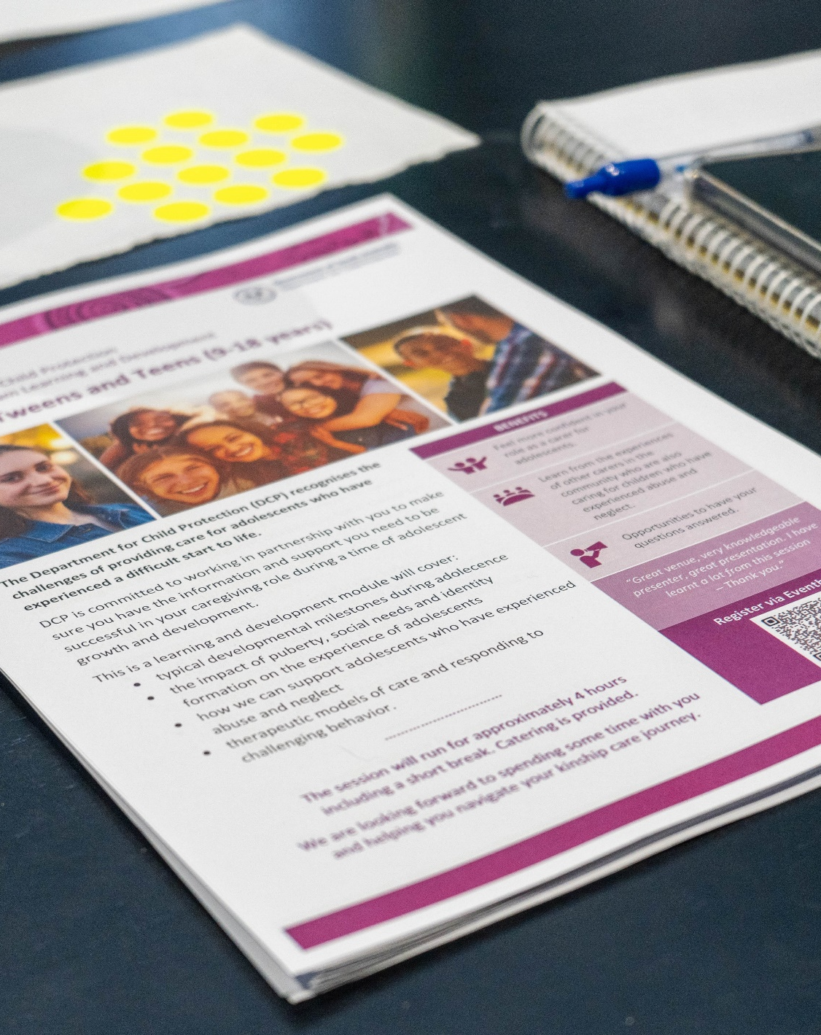
Resources
DCP Carer Platform
Alcohol and Drug Foundation (ADF)
Aboriginal Drug and Alcohol Council (ADAC)
Raising Children Network
NoFASD
Emerging Minds
KnowYourOptions
Healthdirect
SA Health (DASSA)
Nunkuwarrin Yunti
Notes:
We would like for you to leave here today with some links to other resources.
DCP Carer Platform offers:
Resources for carers
Access to the KC learning and development calendar
Caring for Children and Young People with Trauma online training
Iceberg fact sheets
ADF offers:
- Drug facts
- Resources
- National hotline
- Help and support
- Drug and alcohol services
Raising Children Network offers:
Information about child development of all ages
Having difficult conversations about AOD
Brief videos from other caregivers with tips and strategies
NoFASD offers:
Information specific to FASD diagnosis
Fact sheets
Help and support
Training and education
Parent tool kit
Emerging Minds provides:
Online and face to face options for parent/caregiver learning and development in all areas of raising children with a trauma lens
KnowYourOptions is:
A website with information about how to seek help for someone who misuses substances
Signs and symptoms of possible use
Support and counselling services links
Healthdirect has:
Tips for helping someone who is misusing alcohol or other drugs
Tips for holding a difficult conversation about someone’s substance use
Service finder directory
Fact sheets, additional resources and support.

Slide 27
For more learning and development opportunities:
Ask your support worker
Visit the DCP Carer Platform
Stay informed by joining DCP Facebook page
Keep an eye out for the Caring Together Newsletter
Any questions?
Notes:
Thank you all for taking the time out of your lives to join the group today. The best thing that we can do for our kids to stay connected and informed. There is a list here of other ways that you can stay connected and informed, although we would like to see you again at one of the other learning and development sessions we have on offer.

Slide 28
Document control
Reference No./ File No.
Document Owner |  | Lead Writer (name, position)
Directorate/Unit: Strategy, Partnerships and Reform |  | Senior Project Officer, Strategic Projects, Strategy, Partnerships and Reform
Accountable Director: Executive Director Strategy, Partnerships and Reform
Commencement date |  | Review date
Risk rating Risk Assessment Matrix | Consequence Rating | Likelihood | Risk Rating
 | Minor | Unlikely | Low
REVISION RECORD
Approval Date | Version | Revision description
2024 16/05/2025 | 1.0 1.2 2.0 | Approved Small edits made to remove specific Kinship language for use by all carers Updated link provided for NOFASD video
___________________________________________________________________________________________________________________________________________
The Impact of Alcohol and Other Drugs on Families and Children Slide 30/30
V1.0 November 2024

