Slide 1


Helping kids thrive:
Case plans and
what they mean
Learning and development
for foster and kinship carers

Slide 2

Acknowledgement
In the spirit of reconciliation, we acknowledge the Traditional Owners of the land on which we meet today and their connections to their land, seas and waters. We pay our respect to their Elders past, present and emerging and extend that respect to all Aboriginal and Torres Strait Islander peoples here today

Slide 3
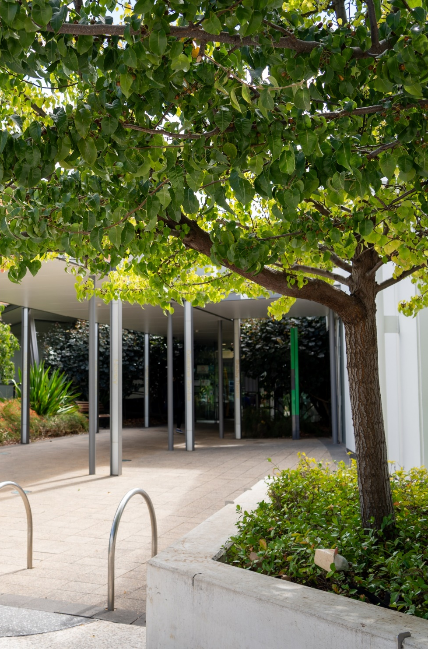





Housekeeping
Emergency protocol/exits
Toilets
Breaks
Mobile phone use
Group norms
Notes:
Welcome carers to today’s learning and development module
Outline emergency exits and evacuation plan and location of toilets and other facilities
Notify carers about break times and catering provided
Encourage carers to make sure their mobile phones are on silent
Group norms to be discussed and agreed (privacy, confidentiality and psychologically safe spaces).

Slide 4
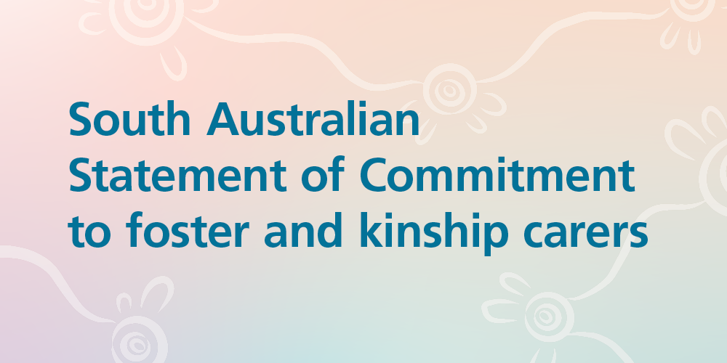
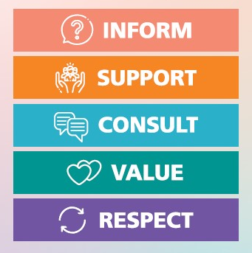
Notes:
The South Australian Statement of Commitment to foster and kinship carers was jointly made by the Department for Child Protection (DCP), Connecting Foster and Kinship Carers SA Inc, and Child and Family Focus SA. It recognises that we must work in partnership and value carers as an essential and respected part of the care team for children and young people. This document highlights the core commitments the department has made to carers, including that we will inform, support, consult, value and respect all carers. The Statement of Commitment also outlines the roles and responsibilities of everyone involved in family-based care.
The purpose of the Statement of Commitment is to act as a supporting document for carers when working alongside child protection staff, and it also informs best practice for staff.
The Statement of Commitment has a unique QR code on the back. You can use your smart phone to scan the code, and it will direct you a webpage where you can read and learn more about the Statement’s 5 pillars.

Slide 5
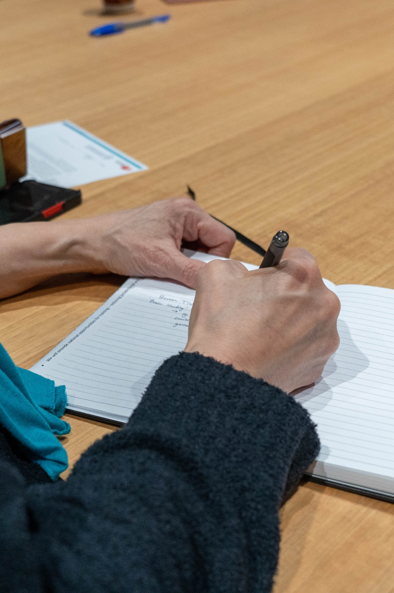

Purpose and learning outcomes
By the end of today’s session, we would like for you to:
Have an increased understanding about how a child’s case plans is developed, implemented and evaluated
Feel confident in your role in contributing to case plans and supporting children and young people’s participation
Understand your role in helping children and young people thrive with support from the care team
Notes:
Together, we have a shared vision to support our children to grow up happy, healthy and strong. The DCP case plan is designed to help the care team around the child to achieve their goals.

Slide 6
Hopes and dreams for our children and young people
Notes:
Case plans include the hopes, goals and aspirations for children and young people that are shared between the child/young person, those who are most important to them, DCP as the child/young person’s guardian, you (carers) as the child/young person’s primary caregiver and any others in the care team who has an interest in a child/young person’s wellbeing.
Activity
Have each participant record a hope or dream for their child/ren and place it in the jar (or appropriate alternative). Read each aloud, anonymously.
This activity is designed to begin the session by bringing the group together with shared visions and hopes for our children’s future which also contributes to a positive group dynamic, builds connections, and fosters trust.
Following an introduction to the activity, if required, provide the group with some examples that may not have been identified, such as:
- to feel safe, secure and loved within the family unit
- to maintain connection to culture, country and community
- to develop rich relationships with both parents (where applicable) and their siblings
to feel supported and encouraged to pursue their interests and talents
to enjoy and gain pleasure from being with others and to have the ability to develop lasting friendships and relationships.

Slide 7
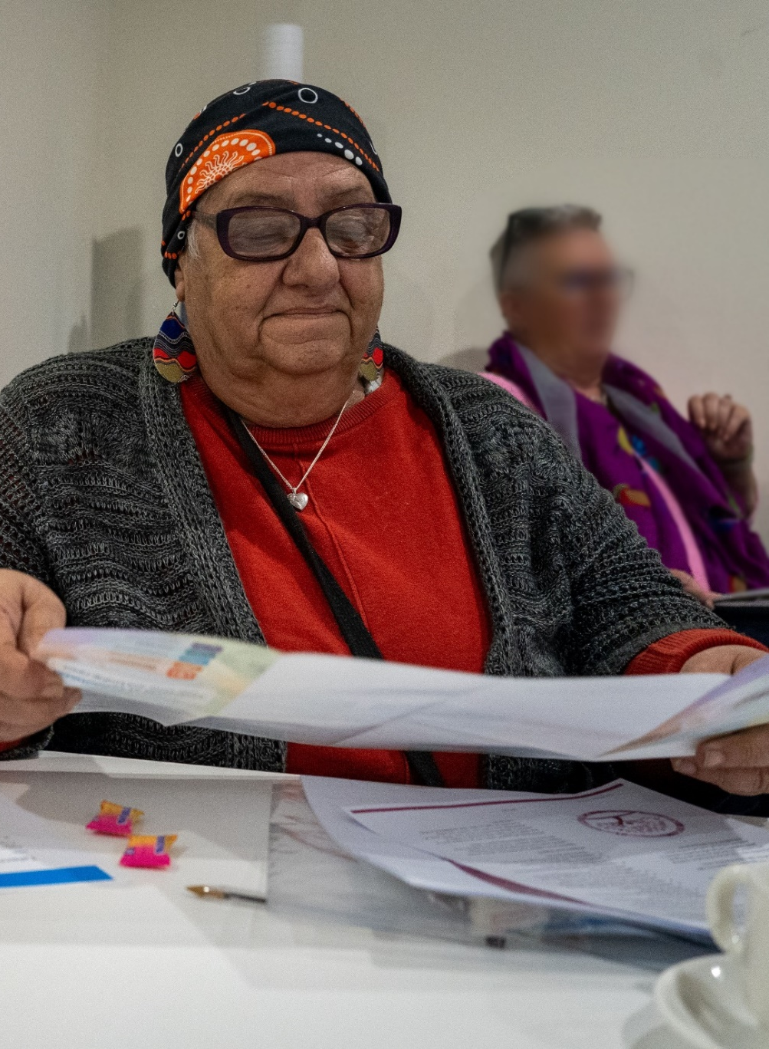
Case plans
Under Section 28 of the legislation it says that the child and young person who is under the guardianship or custody of the CE must have a case plan prepared and maintained and that the child’s views are recorded
Under section 82, carers are entitled to participate in decision-making processes about the health, safety, welfare and wellbeing of children and young people. The DCP case worker must ensure that the child or young person’s carer is an active participant in the case planning process
Notes:
The outcomes of a case plan align with the case plan goal which will be either reunification, long-term care or transition from care.
For reunification case plans, the goal is to reunify a child or young person with their birth parent/s, so the case plan will reflect this. The DCP case worker will assess the child or young person’s needs and identify the outcomes and associated actions required. The case plan describes what will be demonstrated, and by whom, to address child protection concerns and to ensure that the child or young person is safe, and their needs are being met.
The aim of a long-term care case plan is about permanency planning and placement stability. When a child turns 16 years of age, the case plan goal will change to focus on a young person’s transition from care needs.
Read slide
Regardless of the stage of the child’s care journey, the DCP case worker must work in partnership with you, the child/young person’s birth parents and professionals involved in the case plan to agree on the actions. Every case plan will remain child-focussed, have shared responsibilities, and maintain cultural safety. Case plans are also a great way to share information, respond to differences of opinion and build relationships within the care team.

Slide 8

Case plans
Case plans support us to recognise and respond to the child or young person’s need to:
Feel safe
Grow up strong in their cultural identity
Remain connected to family, community and culture
Know where they come from and where they belong
Experience love and develop healthy relationships
Enhance their self-esteem
Achieve their full potential
Have their voice heard and their views shared

Slide 9
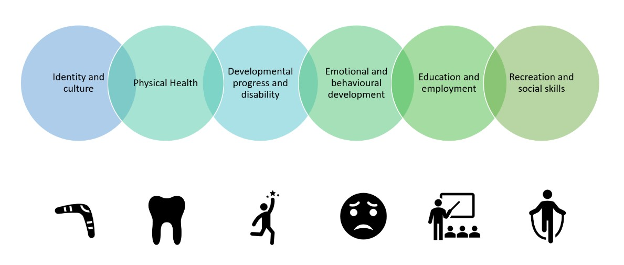
Notes:
Life domains within the case plan are, identity and culture, physical health, developmental progress and disability (if relevant), emotional and behavioural development, education and/or employment, recreation and social skills. For young people 16 and over, independent living is a life domain. Your views and comments are recorded in each of those sections as a valued member of the child or young person’s care team.
DCP case workers will collect information to develop the case plan in many different ways, including, formal meetings with birth parents, home visits, chatting with children and young people informally during transport, via phone or email with you or other professionals.
All carers have the right to obtain a copy of their child or young person’s case plan.
We will now spend some time discussing each of these life domains.

Slide 10
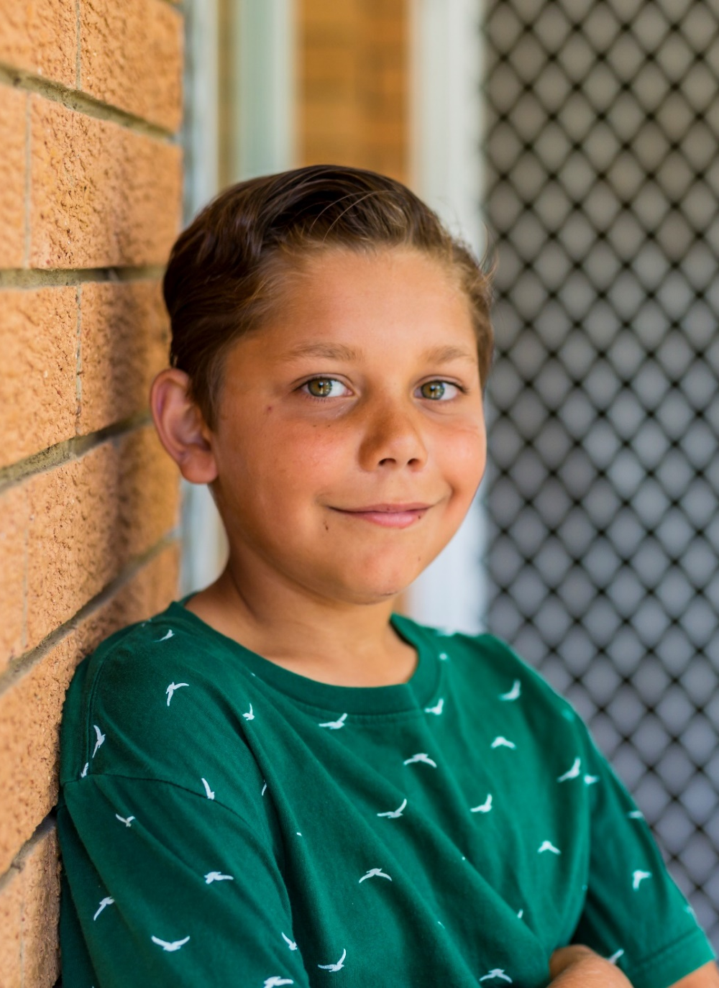
Identity and culture
A child’s sense of who they are might be based on:
How the child sees themselves and how they relate to others
How the child sees what makes them unique and how they express their individuality
The child’s knowledge of their family, kinship network and community
The child's knowledge and participation in family traditions
The child’s understanding of their cultural or religious background
The child’s understanding of why they are in care
Exploration of gender identity
Life story book work
ACIST
CALDIST
Family contact
Notes:
The focus of this section of the case plan is to support the child or young person to develop an understanding of who they are and where they come from, what makes them unique, their connections to other people in their life and their sense of belonging. The child or young person’s sense of identity and connection to others can be related to a range of environments and experiences including, but not limited to, their placement, contact arrangements, school, community or recreational activities, or, where relevant, their religious community.
Cultural maintenance planning for Aboriginal and Torres Strait Islander children and young people is a requirement under section 28 of the CYP Safety Act.
The Aboriginal Cultural Identity Support Tool (ACIST) is included in case plans for children identified as Aboriginal and/or Torres Strait Islander. Identification of a child or young person’s Aboriginal and Torres Strait Islander status is essential for all children and young people entering care. Aboriginal and Torres Strait Islander identity is more than listing the cultural status of an infant, child, or young person. An Aboriginal and Torres Strait Islander infant, child or young person’s cultural identity is made up of their Nations, family stories, language, traditions and relationships, and Aboriginal ways, beliefs, and values. Missed opportunities to identify can have long lasting detrimental impacts.
Many other professionals may be involved in case planning for identity and culture, they may include DCP Principal Aboriginal Consultants, partners from Aboriginal Community Controlled Organisations and/or Community Elders. The Aboriginal and Torres Strait Islander Child Placement Principle is a principle that ensures that active efforts are made to place Aboriginal and Torres Strait Islander children and young people within their family and community. Case planning at the time of placement is essential for the Aboriginal and Torres Strait Islander Child Placement Principle to be fully implemented.
When a child or young person is in care, it is essential that they are supported to maintain and build connections with important people in their lives. This may include their parents, kin, siblings, extended family members, friends, previous carers and other people who are significant to them. Contact can occur face-to-face or via other means, such as video or phone calls. There may also be circumstances where face-to-face or other types of contact may not be appropriate or in the child or young person’s best interests. A contact determination sets out these arrangements and must be included in the child or young person’s case plan.
You are able to offer valuable information to the care team about your child or young person’s connections to family, kin and community. Your knowledge and understanding of a child or young person’s needs as a primary caregiver is essential for good case planning.
If you wish to know more about family contact and how to support positive relationships for your child, you can attend the learning and development module ‘Supporting Family Contact’.

Slide 11

Supporting children’s identity
Life Story Work is a narrative form of therapy where a child is encouraged and supported to keep a record of their life and their life experiences as a child in care and helps them to:
To know where they come from
Make sense of their journey
Build a healthy sense of self
Develop identity
Feel a sense of belonging
Build a sense of connection
Heal from trauma
Notes:
It is a requirement that all children and young people in care are supported to undertake regular Life Story Work. This is a way for children to continue to revisit this record to build a realistic and factual account of their life as they grow. When supported by a nurturing and responsive adult, Life Story Work is a successful way to assist children to build and maintain a positive sense of self and positive sense of identity. When a child or young person is able to make sense of their past, it supports emotional stability in their present and can improve their self-esteem and wellbeing. Being able to make sense of their present helps them to develop a clear sense of identity for the future.

Slide 12
Life story books
Notes:
Life story books provide a process to develop a balanced and realistic narrative of their past and their present and able to integrate this narrative into their sense of self and is an ongoing process that commences when children first enter care and continues until they transition to adulthood.
It helps children and young people to gain a sense of themselves and their place through stories and mementoes that they collect and is a process of gathering and curating memories. Most families have stories – children are curious about their milestones, first words, when they first walked. We may have stories that are about moments in their childhoods that become family legends and as parents these are the things we talk to our children about when they ask questions. We collect and gather information for our children, and we keep special things e.g. paintings they did at school or pictures or birthday cards etc.
What can be included in the life story book?
Genogram
Infant health records
Birth certificate
Developmental milestones
Photos
Information and photos or mementoes of country for Aboriginal and Torres Strait Islander infants, children and young people
Language maps
Family contact photos/art/craft
Letters from significant others
Stories from significant people in their lives
Certificates and awards
School reports
Attendance at cultural events
Plans for return to country
Information about the exploration of culture, including which country the child or young person’s birth parents come from, their familiar kin and cultural background, religion and/or language, any national foods or dress, holidays and special events associated with their culture and/or religion.
As a carer, you have an important role to regularly take photos and keep memento of special events to contribute to your child’s life story book.
Aboriginal life story books are available to order through the DCP case worker.
It is essential whilst engaging in life story work to ensure that children and young people are supported and encouraged by you and their DCP case worker (and any other significant supports) to express and work through their feelings.
Life story work does not need to occur in order. Children and young people at times may only want to focus on a narrative about the present or may want information that is not sequential. When engaging in life story work with children and young people, we need to consider the child or young person’s age, developmental stage, level of functioning or any disability. This will ensure that life story work meets the child or young person’s needs.
Activity: Life Story books - If you were the child or young person, what would you want to know about your life? Who would you want to be involved in helping you understand your story?
Record ideas.

Slide 13

Physical health
The case plan will address questions about a child or young person’s physical health, such as:
Preliminary health checks
Comprehensive Health and Development Assessment
Dental checks
Medical needs and treatment
Immunisations
Any ongoing health conditions
Notes:
The case plan will also consider:
What plans are needed to meet ongoing or chronic health conditions?
What specialist services may be required to meet their health needs?
Is the young person aware of their health conditions or family (genetic) health conditions, if any?
Does the young person know how and when to access all health services for preventative or urgent care (such as when they can visit a chemist, when to go to the GP, when to attend emergency departments and when to call an ambulance)?
Does the young person have a general practitioner or clinic they are comfortable accessing?
Has the young person been linked in with dental care providers, and do they know how to access services for preventive and urgent care?
Has the young person talked about or considered their needs in relation to their sexual health, including having safe relationships and managing reproductive health?
Regular health reviews should occur (e.g. annually or as determined by the GP/paediatrician) as part of ongoing health and development support based on individual need and circumstances.
Your knowledge of the child or young person’s health care needs will be important to share in a care team meeting. For good case planning to occur, your day-to-day observations and in depth understanding of any ongoing health conditions will ensure that the care team is informed and responsive to any changes that may initiate a case plan review.

Slide 14
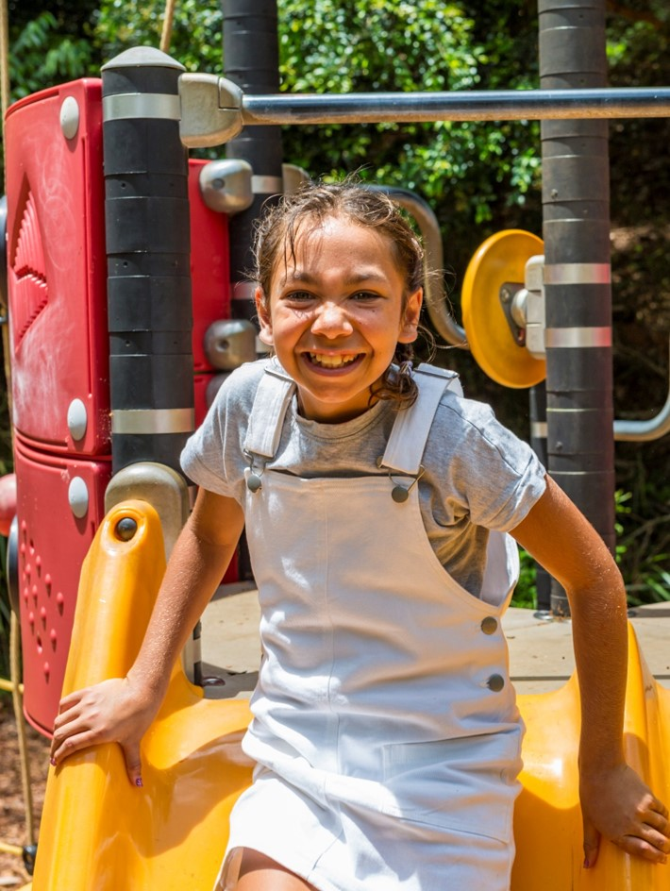
Supporting children’s physical health
The following are in place for children and young people in care:
Medicare card
Health care card
Preliminary and comprehensive health checks
Immunisation records
Sport/recreation
SA Dental
Ambulance cover
Notes:
DCP and SA Health will work in partnership to ensure that the health needs of children and young people in care are met through timely assessment and referral.
Read slide – and speak to each point referencing the information below
Medicare card – children in care require their own Medicare card. When children first come into care, there may be some time before a child is allocated a Medicare card, because there is process to alert Medicare to the change in guardianship and the allocation of a new card. In absence of a card, you may be offered the Medicare number by your DCP case worker in the interim.
Health care card – all children under guardianship of the Chief Executive are eligible for a health care card which will entitle them to free or gap-free health care and low-cost prescriptions. It is the DCP case worker’s responsibility to apply for this on behalf of a child or young person.
Preliminary health checks – all children and young people will be supported to have a preliminary health check within 30 days of entering care. This is a baseline assessment of their overall health and wellbeing and can further input into case planning for children physical health as well as social and emotional wellbeing.
Comprehensive health and development checks – within 3 months of being in care, children can be referred to a paediatrician for a comprehensive health and development check.
Immunisation records (no jab no play) - DCP case workers can access children’s immunisation records (0-14 years) through My Health Record that is centrally managed by the department. The South Australian Public Health Act 2011 states that children under six years of age are prohibited from enrolling in or attending early childhood services (including childcare, family day care, preschool, occasional care, kindergarten and early learning centres) unless their immunisations are up to date. COVID, FLU and Meningitis are recommended.
Sport and recreation – under Who Pays for What, it is the carer’s responsibly to use carer payments to provide children with access to an extracurricular activity of the child or young person’s choice, however, DCP will agree to separately fund a second activity under negotiation with the DCP case worker, if this is a goal in the child or young person’s case plan. For example: Jonny has been assessed as having low muscle tone, hence both swimming lessons and soccer club are beneficial to meet his physical development /health needs and are recorded in his case plan. The sports vouchers program through the Office for Recreation, Sport and Racing can also save carers up to $100 per child, per calendar year on sports, dance, learn to swim, scouts/guides fees.
SA Dental – children in care can receive free dental check-ups, emergency dental and orthodontic care until they reach 18 years.
Ambulance cover – Children and young people in care have free ambulance cover through SA Ambulance Service.
The Who Can Say Ok document provides carers with information about roles and responsibilities, and these can be recorded in the case plan. For example: Referral for health assessment will be the role of DCP, daily care and administration of prescription medication remains the responsibility of the carer. All Aboriginal children and young people in care should also attend their regular Health Assessment for Aboriginal and Torres Strait Islander People in addition to their other health assessments.

Slide 15
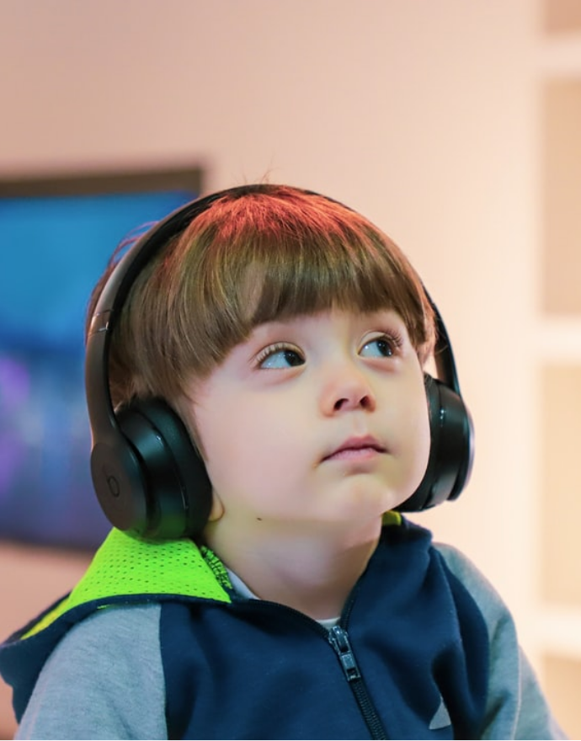
Developmental progress and
disability
Under this life domain, the following is recorded:
Developmental assessment
Current diagnosis of developmental delay or disability
Outcomes of professional assessments and reports
What supports you may need to understand and meet a child’s complex needs
Therapy or treatments plans
Referrals for specialist support
NDIS Plan
Notes:
This a section of the case plan where the developmental or disability needs of a child or young person are recorded and goals are established in response to the specific needs of each child as an individual. This can be applicable to children with or without a developmental delay or disability diagnosis. Early intervention and early action is crucial for helping children to thrive and meet their full potential and as a carer, your input and voice in this section of the case plan is very important because you know your child or young person best.

Slide 16
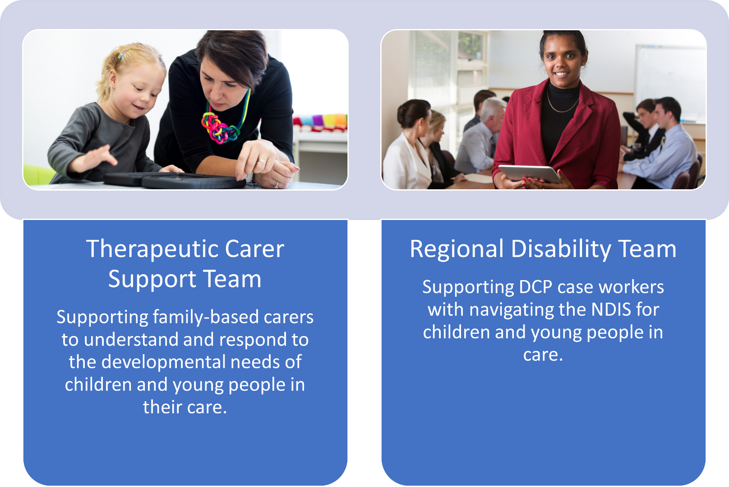
Notes:
The Therapeutic Carer Support Team (TCST) in DCP provides short-term in-home support to family-based carers to assist with understanding children’s development, strengthening relationships, and building capacity for continued care acknowledging the challenges that come with parenting children and young people with additional needs.
Families can be referred by their DCP case worker or support worker when the child or young person being cared for has delayed development but is not eligible for National Disability Insurance Scheme (NDIS). Referrals of Aboriginal and Torres Strait Islander kinship care families will be prioritised, and Principal Aboriginal Consultants (PACs) will be consulted as part of the referral process for all Aboriginal and Torres Strait Islander children or young people to ensure support provided is culturally sensitive.
The Regional Disability Team is an internal DCP program that provides DCP case workers with a layer of consultancy and support for children and young people who have been identified as having developmental delay or disability. The team does not have contact with carers directly, however, they can provide specialist knowledge and expertise to DCP case workers – often during case planning when goal setting to meet a child or young person’s needs is being considered. They also provide case workers with support in setting up and accessing NDIS Plans. If you think you or your case worker could use extra information on this, you can suggest that the case worker invite a Regional Disability Consultant to a care team meeting.
Asking for help and support to manage and respond to the complex needs of children and young people is a strength. Remember, caregiving is a shared responsibility and there are supports available to you and your family. During a case plan meeting, you will be provided space to speak to the child or young person’s daily functioning and help the care team identify any developmental gaps that need attention and/or assessment or referral to better meet the child or young person’s needs.
If you would like additional support to understand your child or young person’s developmental and/or disability needs, you can register to attend one or both of the learning and development modules: ‘Caregiving Support: Children with Additional Needs’, and/or ‘Understanding the NDIS’.

Slide 17
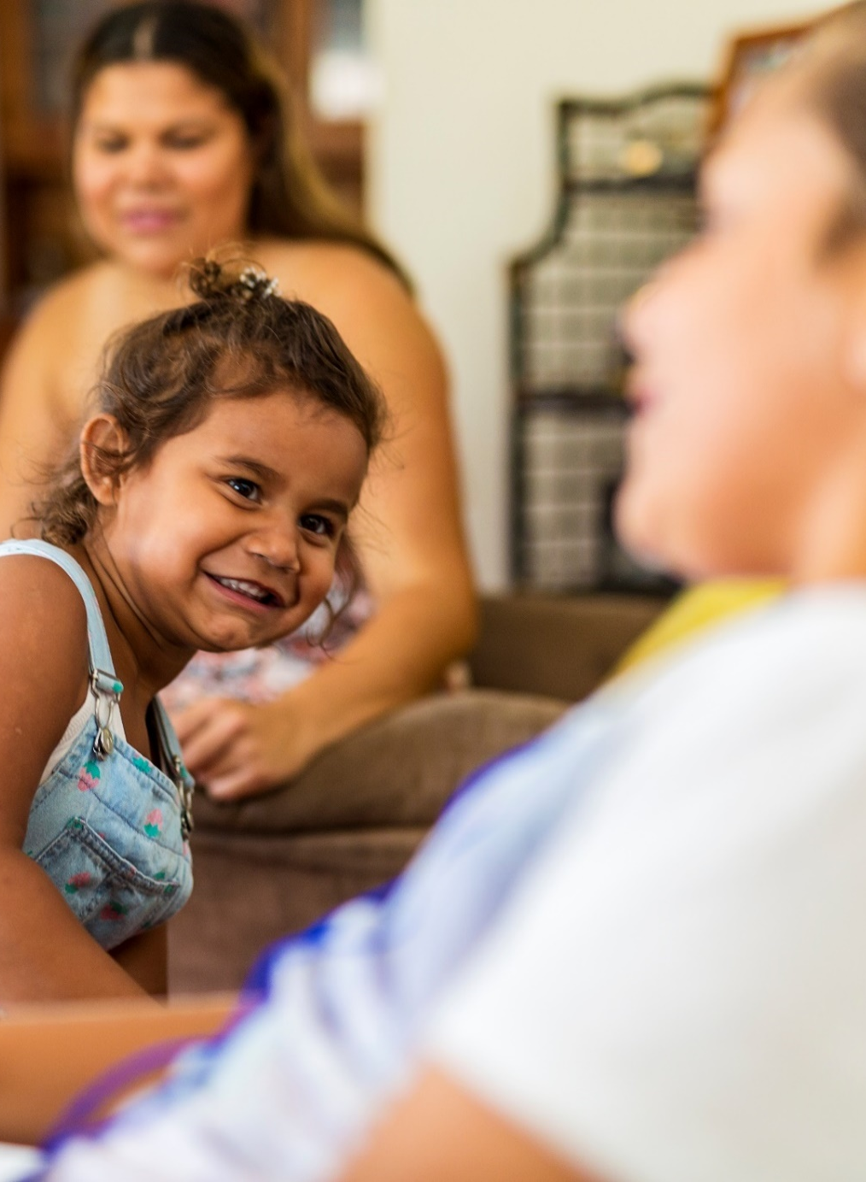
Emotional and behavioural
development
Under this life domain, the following is recorded:
Consultations, assessments and professional reports
Assessment of a child’s emotional functioning and behaviour in different environments
The child’s recovery from their experience of harm
Ongoing or emerging concerns for mental health
Any factors that may impact upon a child’s wellbeing or mental health
Youth Justice involvement
Mental health care plan
Referral information
Any additional support you may need from the care team
Notes:
Where a child or young person is displaying complex behaviours, consideration is given to therapeutic support. Some children or young people may be resistant to engaging directly in therapy or this may be assessed as not appropriate for the child or young person’s age or capacity, but professional therapeutic input should still be considered as it can still be highly beneficial for carers and the care team. Where it is unclear which referral pathway is most appropriate, consultation with DCP Psychological Services occurs.
DCP Psychological Services is a resource available to DCP case workers to consult with about pathways for therapeutic assessment and support. With professional advice, children and young people have a better opportunity to receive referral, assessment and support from targeted services specific to them. In the case plan under the life domain ‘emotional and behavioural development’ some information about the following may be recorded here:
You, your child or young person and anyone else involved in the health and wellbeing of a child may contribute to the goal setting for this life domain. You have the right to ask questions and a rationale for decisions made, you have the right to have copies of the child or young person’s assessments or professional reports to help you better understand their needs.

Slide 18

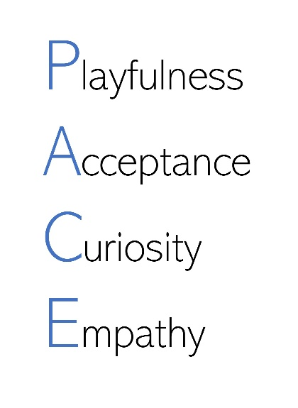
Therapeutic models of care
’The adult will stay with the child emotionally, providing comfort and support… The adult is also communicating strength, love and commitment, with confidence that sharing the child’s distress will not be too much. Together they will get through it.’
- Dan Hughes
On the surface: Behaviours that we see
Underneath: Needs that drive the behaviours
Notes:
This part of the case plan is a chance to reflect on what a child or young person’s emotional and behavioural development needs are and the needs of the carer in supporting, managing and responding to those needs. Let’s look at two examples of therapeutic models of care, PACE and the Iceberg model.
PACE stands for PLAYFULNESS, ACCEPTANCE, CURIOSITY, EMPATHY.
PACE can be used by any adult to validate, explore and understand children’s feelings. It is an approach which limits shame, promotes compassion and brings a sense of mutual support, strength and resilience. When an adult spends time and demonstrates an interest in a child’s inner life the adult contains and regulates the child’s emotions, eventually the child will learn to do this themselves.
The Iceberg Model – at times, you might need to respond to behaviours which are challenging, or you feel unsure about. The Iceberg Model can be really useful in helping you understand why the child or young person is behaving in this way and what you can do to better support them.
With an iceberg, we can usually only see the very tip, the bit that’s visible above the surface of the water. But underneath the water is a huge base of ice, which is holding up what we see at the top. That huge base of ice is the big feelings, thoughts or memories a child has that is driving their behaviour. This is a great model to keep in mind when children are behaving in frustrating and concerning ways – the behaviour is just a clue to what’s really going on for them. And the only way to change the behaviour, is to address the unmet emotional need underneath – this is helpful to know, as it can change the way we respond to children.
Iceberg model in action: Ivy in family-based care
13-year-old Ivy tends to push her caregiver away. She ignores invitations to do activities together, rolls her eyes and makes sarcastic comments when they try to talk with her, and wants to do everything for herself. Ivy’s caregiver listens to the messages underneath this behaviour - “I need to keep you away or you’ll let me down. I can’t rely on you or anybody else. The only person who really cares about me is me”. Ivy’s caregiver responds by gently persisting with invitations to do activities together focusing on Ivy’s particular interests, paying attention to her likes, buying foods and household goods she prefers and continuing to offer caregiving support in a way that acknowledges Ivy can do it for herself if she wants to.

Slide 19

Education/employment
Under this life domain, the following is recorded:
Engagement in childcare, kindergarten, school, training or employment
Child’s achievements, and challenges or barriers they are experiencing
One plan (personalised learning plans) or modified curriculum
Your feedback on how children are progressing
Engagement of supports for a child with developmental delay or disability
Short-term and long-term aspirations and goals
Cultural needs
Additional support services to address barriers
Transition points (kindy to school/high school)
Notes:
Inclusive, accessible and quality education promotes healthy development and lifelong opportunities. For children and young people in care, their preschool or school can be an important source of safety, stability and positive relationships.
Children and young people in care have access to a range of educational supports to meet their learning needs and achieve positive educational outcomes.

Slide 20

Education/employment
Some of the supports available to children in care are:
School card
Early entry into preschool from the age of 3
Education grant
Catholic School Scholarships program
Childcare subsidy
Stability in Family Based Care program and ongoing carer payments
School Services Officer (SSO)
Tutoring/mentoring - School Retention Program
NAPLAN adjustments
Tailored learning (formally FLO)
Vocational education/training
Australian Apprentices program
Support for enrolment in university
Priority choice of school in year 7
Notes:
All children and young people are of compulsory school age from the age of 6 years until they turn 16 and are required to fully participate in the education program arranged and approved by their enrolling school. Young people between the ages of 16 and 17 are of compulsory education age and are required to participate in an approved learning program until they turn 17, or until they have achieved an appropriate qualification under an approved learning program, whichever happens first.
As a priority group, children and young people in care receive a range of priority services at South Australian government preschools and schools. DCP case workers, as the child’s guardian, are responsible for enrolment, to ensure that education student support services are aware that the enrolment is for a child in care, so that additional funding and support can be applied.
As a carer, you play an important role in supporting the educational outcomes of the child or young person in your care. One of the tools that can support a child or young person’s education is the One Plan. The One Plan is a personalised learning plan that contains information to support a child or young person’s inclusion and achievement in preschool and school. As a priority group, all children and young people in care are expected to have a One Plan.

Slide 21

Recreation and social skills
Under this life domain, the following is recorded:
A child’s participation in social or recreational groups or activities
Interests in participating in any new social or recreational activities
Whether the child has the appropriate tools/equipment
Access to transport and funding
Any additional practical or financial supports identified
Notes:
Children’s participation in recreational activities in areas of strength and interest has many benefits for children’s overall health and skill development. For some children and young people, recreational activities can be a method for building other areas of their development such as relationships. Being involved in group based or individual activities also provides children and young people with opportunities for success, learning trial and error, managing conflict, working as part of a team, building resilience and experiencing fun and joy. In the case plan, goals may identify activities that address specific needs and identify any barriers and supports that are required that will assist children to participate.

Slide 22

Supporting children’s recreation and social skills
Some of the supports available to children in care are:
2x $100 sports voucher
Vacswim
Sporting tickets
Adelaide Zoo tickets
Christmas parties organised by the DCP offices
Camps
Playgroups
Notes:
Carer payments cover the cost of supporting children to participate in an extracurricular activity. DCP has some partnerships established with community-based organisations to support children and young people’s access to activities such as:
1. 2x $100 sports voucher for children in care to contribute to the cost of signing up to sports or other physical activities. Your DCP case worker can support you to find an approved provider in your areas and support you to register
2. Free Vacswim program for children aged 3- 12 years, throughout December and January in school holidays. Carers can sign up by visiting Vacswim website
3. Through partnerships with the Office for Recreation, Sport and Racing and a number of sporting clubs, the department receives free tickets to sporting events to distribute to children in care, like the Adelaide Crows and Port Power games. Similarly with the Adelaide Zoo tickets
4. The DCP offices hold annual Christmas party events for children and their families. These events are free and can be a great way to connect with other carers and for children and young people to connect with siblings
5. Camps are run by many NGO providers that support the health and wellbeing of young people in care: Puddle Jumpers, Operation Flinders, Edmund Rice camps etc. Have a chat with your child’s DCP case worker
6. Playgroups – local community centres and libraries run free programs during school term and special activities during the school holidays for babies and school aged children. Check out your local council website.
It is in the section of the case plan that you are able to identify any barriers to accessing social and recreational activities for your child or young person. This may include, transport, tools or equipment or additional support to accommodate a child or young person’s social, emotional or health care needs so that they are able to fully participate. In doing so, the care team can support you to find solutions, seek additional funding (where negotiated) or assist in sourcing social and recreational activities that meet the specific needs of young child or young person (disability, developmental delay).

Slide 23

Transition to adulthood
A transition from care plan commences from 16 years old which focuses on setting young people up for success with intensive support from DCP and therapeutic services (where appropriate) alongside your support and guidance
Driver licence
Application for Centrelink benefits (youth allowance)
Housing/accommodation options
Education and employment pathways
Building and maintaining social and community relationships
Reviewing and assessing developmental/disability needs
Management of finances
Notes:
DCP case workers must actively engage in timely and proactive transition planning with young people to ensure young people are supported and have the best chance of experiencing stability, continuity of relationships, connections with services and are able to access necessary supports into adult life. This begins at 16 years of age, even if the plan is for the young person to remain in your care post 18 years, although we do encourage these conversations to start much earlier. At the age of 18 years, the guardianship order expires, however, this does not mean that a young person needs to leave your care. Fortunately, carers will continue to be supported to provide care for young people post 18 years.
For Aboriginal and Torres Strait Islander young people, traditional perspectives see adolescence as a time when young people go through the processes of becoming an adult and establish their place with their community. Decisions about maintaining and supporting the young person’s contact with family, kin, community, culture and Country is important to consider in this part of case planning.
To develop the case plan to support transition to adulthood, key tasks will need to be completed between the ages of 16 and 18 years of age to support a successful transition. These tasks should build on previously achieved tasks. Specific attention should also be paid to monitoring the young person’s wellbeing and any emerging mental health issues that may be triggered by the process of moving towards adulthood.
The DCP case worker will:
Commence Working with Children Check process if required.
Discuss and plan for contact determinations for contact with siblings remaining in care.
Referral for Stability in Family Based Care/Over 18 Education Initiative programs if appropriate.
Referral for post care services (RASA)
Access funding/grants where available.
Attaining the age of 18 years signifies legal adulthood, but developmentally, the process of maturation (physical, intellectual, social) that signifies adulthood continues into the early 20’s. As their carer, you play a big role in supporting a young person to transition to adulthood.

Slide 24

Supporting transition to adulthood
Bank account and bank card
Original birth certificate and other identity documents, such as a passport
Medicare card
Health care card
Driver's licence or proof of age card
Medical reports and other assessments
Photographs, school reports, certificates, and mementos
Life Story Book or Aboriginal Life Story Book
Most recent case plan (including ACIST for Aboriginal young people)
NDIS plan (where applicable)
Resume
Dame Roma Mitchell Grant Program
Notes:
With the help of the DCP case worker, carers can support children’s transition into adulthood by helping to obtain:

Slide 25
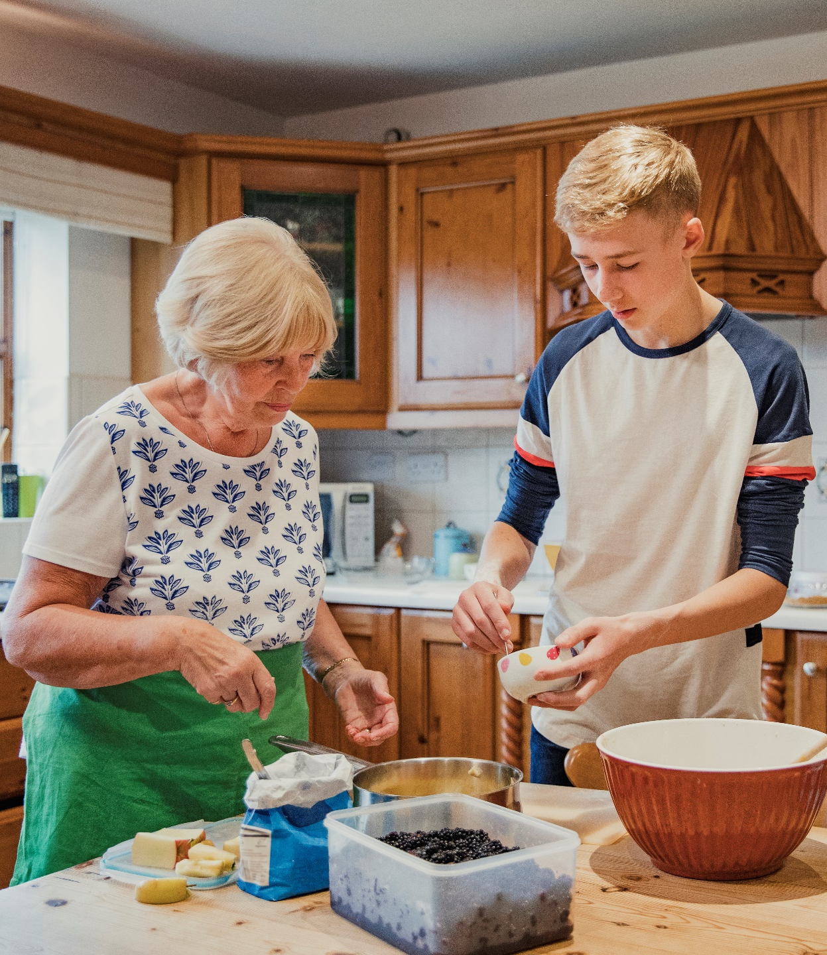
Life/self-care skills
Independent living skills include:
Cooking, including meal planning, grocery shopping and safe food handling
Cleaning and other household tasks
Managing minor cuts, burns, injuries or illness
Navigating public transport
Car ownership, including maintenance, registration and insurance
Managing a home, including paying bills and maintaining a property
Managing money, including budgeting and financial literacy, and completing tax returns
Understanding legal rights, including reading and understanding contracts, agreements and terms and conditions
Accessing government services, including setting up a MyGov Account (this may be done from 15 years of age)
Enrolling to vote
Notes:
Another way that carers can support young people’s transition to adulthood is supporting them to gain skills for life, including independent living skills.

Slide 26
Implementing the case plan
The DCP case worker is responsible for recording the outcomes of contacts and meetings, monitoring progress against actions recorded in the plan, and assessing overall progress toward the case plan goals
Meetings with you are an opportunity to:
Discuss progress against the actions and outcomes and actions toward the case plan goals
Discuss your support needs and address any concerns about the placement
Work in partnership to make decisions
Discuss any feedback about service providers or professionals involved with the child or young person, and whether their support needs are being met
Discuss feedback about contact arrangements, including any issues or concerns experienced in supporting the child or young person before, during and after contact
Discuss any significant changes in your circumstances which may affect the child or young person’s safety or the case plan goal, and options for responding to these changes
Identify strategies for supporting you to understanding DCP processes relevant to case direction
Notes:
Implementation of the case plan and assessing and monitoring progress is best achieved by:
- regular meetings and contact with the child or young person, parents and carers
- contact with family and community members (where appropriate)
- contact with and feedback from professionals and other service providers involved with the child or young person and their family
- direct observations of interactions between the child or young person and their parents and/or other family members, and
- direct observations of interactions between the child or young person and their carers.
These conversations are an opportunity to speak with the child or young person about:
- their views about what is happening in their lives and what is important to them
- any concerns about their safety
- personal issues or concerns they may have
- their views of their placement
- their feedback about contact arrangements
- actions being undertaken as part of the case plan, including cultural maintenance plans
- significant events, including Court proceedings, changes in family contact, and progress towards reunification (if relevant, and with regard for the child or young person’s age, developmental stage and other factors which may impact on their capacity to understand the information being provided)
- for Aboriginal and Torres Strait Islander children and young people, their thoughts on attending events such as cultural ceremonies and traditions (including ‘Sorry Business’ or funerals), caring for Country, naming ceremonies, or Men’s and Women’s Business.
Where the case plan goal is reunification, long-term care or transition from care, the DCP case worker must maintain regular contact and communication with you, the child or young person’s birth parents and key family members, including visiting in your home.
You are entitled to have a copy of the child or young person’s case plan and request a copy following each review. You will have some roles and responsibilities in implementing the case plan as an integral member of the care team, so true partnership can only be successful with effective communication and information sharing.

Slide 27
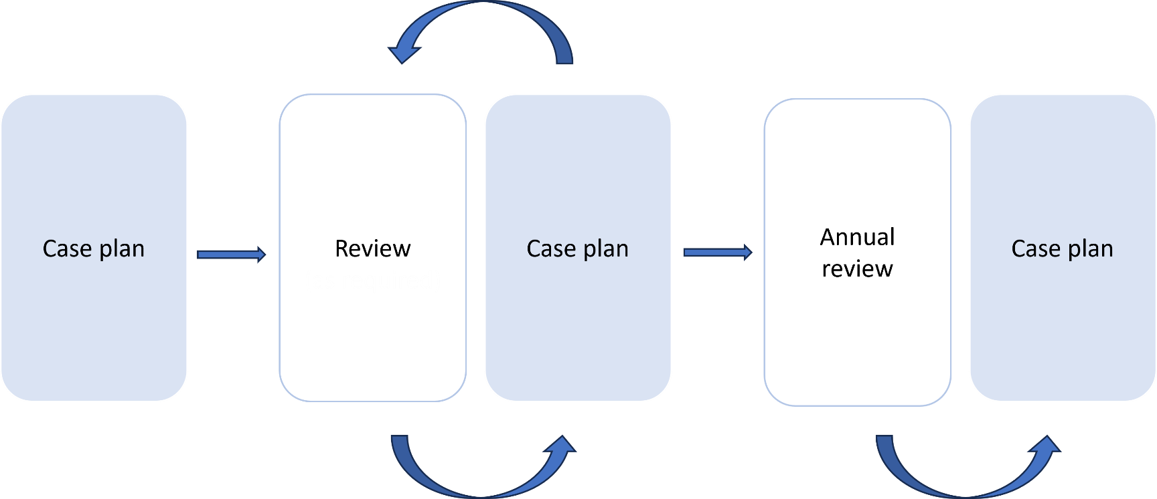
Reviewing the case plan
Case plans must be reviewed and revised when circumstances change that impact the child or young person’s safety and/or needs, their living arrangements and/or the case direction
Notes:
Case plans are a working document, meaning they are constantly reviewed and updated when needed. Examples of instances where a case plan may require review include but are not limited to:
- When it is identified that a child is not safe
- When known risk factors increase that may lead to a child being unsafe
- When there is a decision that case direction will change (for example: reunification to long-term care)
- When there is a change in the child or young person’s placement
- When a child or young person’s behaviours or needs become more complex
- Or when complex behaviours or needs have lessened, and intervention and support has decreased.
As a child or young person’s caregiver, you are also able to request a review of the case plan. You may identify that one of the case plan goals is no longer relevant, a therapeutic service is no longer meeting the child’s needs, there has been significant changes to family contact arrangements, or a child or young person has received a new developmental assessment with recommendations that you feel need to be considered moving forward.

Slide 28

Annual reviews
An annual review is a requirement under the CYPS Act for all children and young people placed under a long-term care and protection order. The purpose of the annual review is to consider whether the existing arrangements for the care of the child or young person continue to be in the child or young person’s best interests.
Notes:
The annual review is carried out with the oversight of an annual review panel led by an independent chair at an annual review meeting. The annual review meeting provides an opportunity to collaborate with the child or young person and their care team to formally review progress over the last year and plan for the future. Existing care arrangements are reviewed, and consideration given to whether they continue to be in the child or young person’s best interests and are supporting them to grow up well cared for, happy, healthy, connected and empowered to reach their full potential. Recommendations made by the annual review panel during the annual review meeting are used to inform the actions and outcomes in the next case plan.
The ACIST must be reviewed regularly as part of the case plan review and annual review process.
If you are unable to attend an annual review meeting due to employment obligations, caregiving responsibilities or other, you are still able to provide your thoughts and comments in a way that suits you best. This can be in written form, via phone or MS/Teams. You will be provided with every opportunity to contribute to the annual review of your child or young person’s case plan.

Slide 29

Encouraging children’s participation
Face to face discussion with the DCP case worker
Completing a child survey
Telephone call with the DCP case worker
In writing (for example, through email, text or letter), where appropriate to the child or young person’s development
Through another DCP worker
Through other means, such as drawings, artwork, photographs, or other media
Notes:
The DCP case worker must notify the child or young person (with regard for their age and development) and their carers of the annual review and invite them to participate. They may do this by attending the annual review meeting in person, making a submission to the panel, or both. The child or young person may also choose to participate in the absence of their carers. If the child or young person is not attending the annual review meeting, they may participate in the annual review in a number of ways.
For children and young people with a developmental delay or disability affecting their intellectual functioning and/or communication, additional supports and flexible approaches may be required to support them to participate in their annual review. The DCP case worker must provide copies of the approved annual review report to the child or young person (if appropriate) and their carers.

Slide 30
Activity – Hopes and dreams in action
Notes:
As we finish this session, we would like you to think back to the hopes and dreams that we came up with earlier in the session.
Activity – Hopes and dreams in action
This activity is designed to help carers to start thinking about connecting their hopes and dreams for their children and young people (as completed in the first part of the session) into actions. Assisting carers to start thinking in this way, will empower them to contribute to the development, implementation and evaluation of the child or young person’s case plan helping them to contribute to decision making.
Set some goals, refering to the things that a child or young person would like to achieve such as learning new skills, gaining independence, or being more involved in the community. It’s up to the care team to identify the child or young person’s goals and develop some actions to support them to achieve this. This may also include identifying what barriers that may exist that could prevent a child or young person from being successful, whether there are additional supports required from members of the care team or whether the child or young person needs any other equipment/resources to assist them.
As a facilitator, provide group or individualised support where required. Once completed, ask someone from the group to share (optional), or if participants are not comfortable sharing, follow the template to demonstrate the activity.

Slide 31
For more learning and development opportunities:
Ask your support worker
Visit the DCP Carer Platform
Stay informed by joining DCP Facebook page
Keep an eye out for the Caring Together Newsletter
Any questions?

Slide 32
Document control
Reference No./ File No.
Document Owner |  | Lead Writer (name, position)
Directorate/Unit: Strategy, Partnerships and Reform |  | Senior Project Officer, Strategic Projects, Strategy, Partnerships and Reform
Accountable Director: Executive Director Strategy, Partnerships and Reform
Commencement date |  | Review date
Risk rating Risk Assessment Matrix | Consequence Rating | Likelihood | Risk Rating
 | Minor | Unlikely | Low
REVISION RECORD
Approval Date | Version | Revision description
___________________________________________________________________________________________________________________________________________
Advocacy in Care – Your voice, your say! Slide 34/34
V1.0 November 2024

